Slide 1
Present Perfect
What has changed?

Slide 2
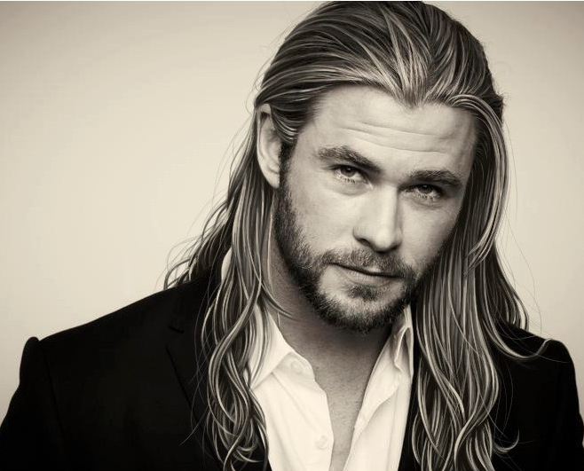
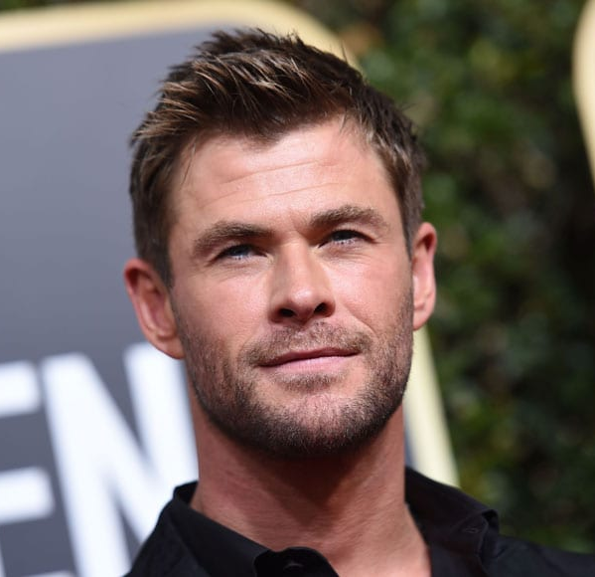
before
What has Chris done?
now
He has had a haircut

Slide 3
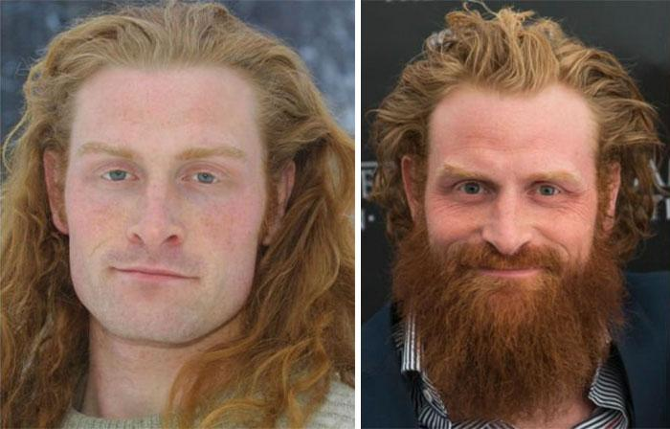
before
How has Kristofer changed?
now
He has grown a beard

Slide 4
before
What have the Grimswolds done to their apartment?
now
They have painted the walls

Slide 5
before
What has Eric done to his car?
now
He has washed it

Slide 6
before
What has Ingrid done?
now
She has tidied her room

Slide 7
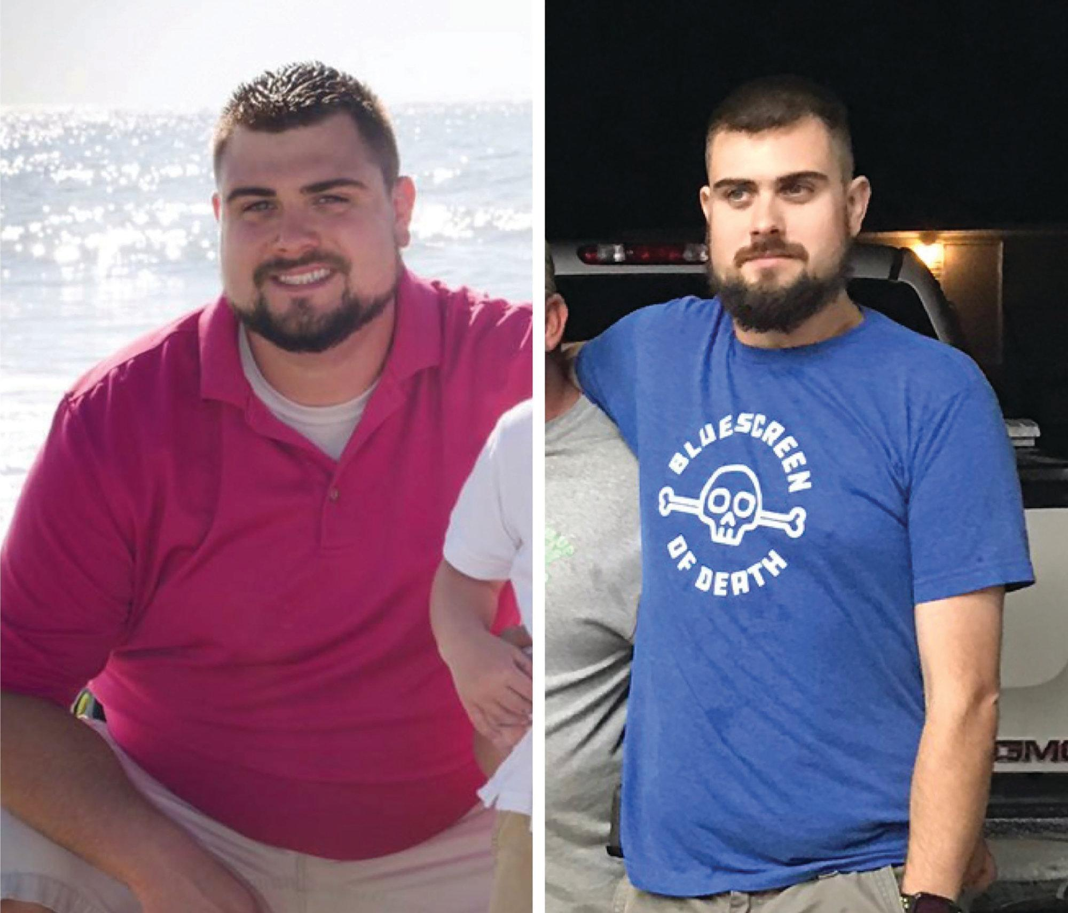
before
How has Viktor changed?
now
He has lost weight

Slide 8
before
What has happened to Tom’s phone?
now
He has broken the screen

Slide 9
before
What has Margaret done with her broken chair?
now
She has repaired it

Slide 10
before
What has Mick done to his boots?
now
He has polished them

Slide 11
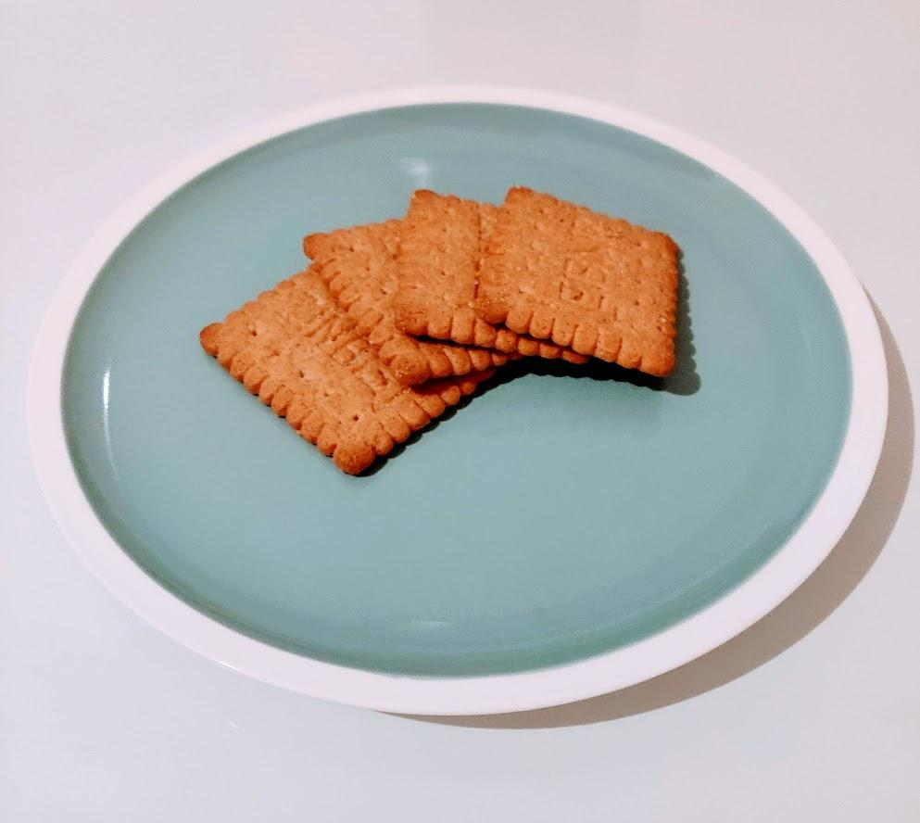
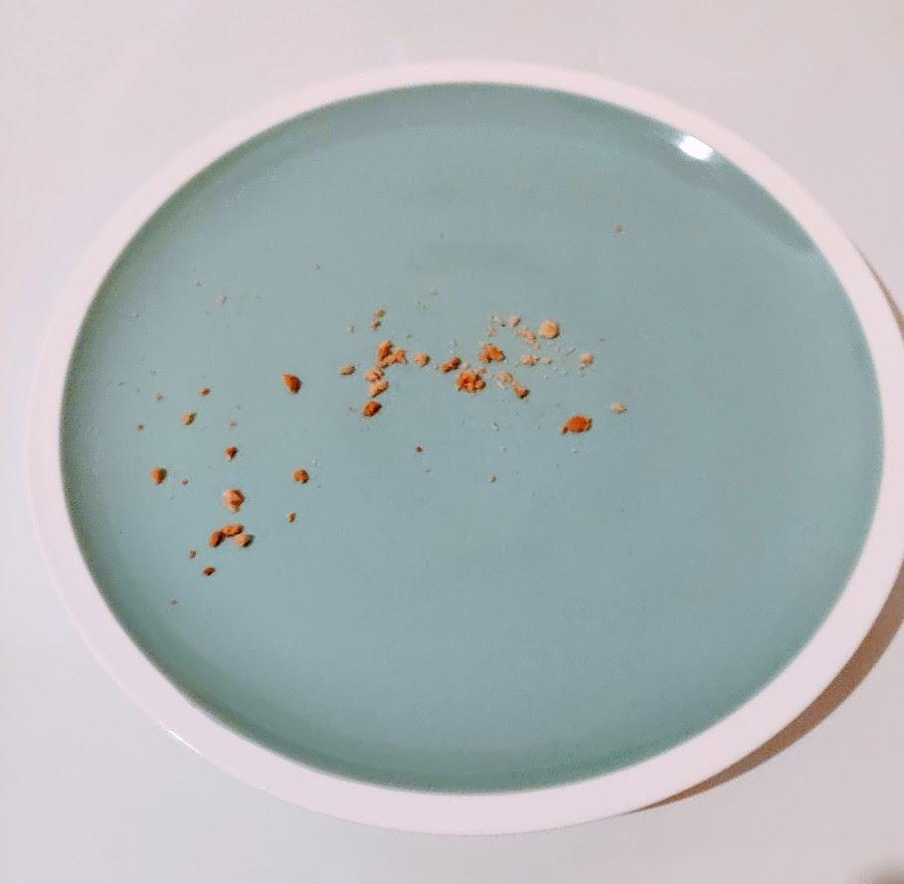
before
What has happened to the teacher’s biscuits?
now
Someone has eaten them

