Slide 1
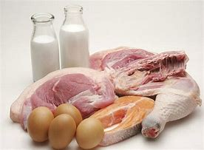
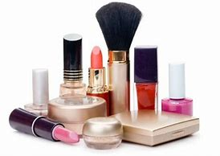
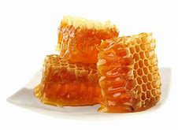
Humanity can’t live without animals.
How do people depend on animals?

Slide 2
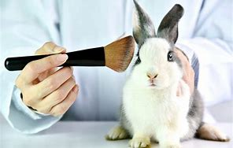
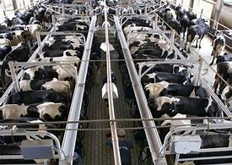
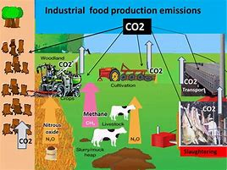
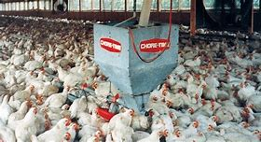
Ethical issues/ injustices with animal uses:
Factory/ battery-chicken farms. Mass meat production.
C02 emissions. Animal testing.
Discuss: What are problems with these practices?

Slide 3
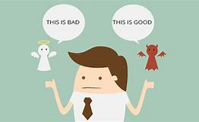
Questionnaire
Which animal products do you consume/ use?
What are the benefits of reducing animal product consumption?
Class feedback: How can we consume animal products ‘ethically’?

Slide 4
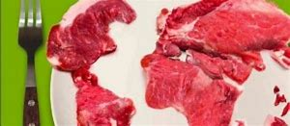
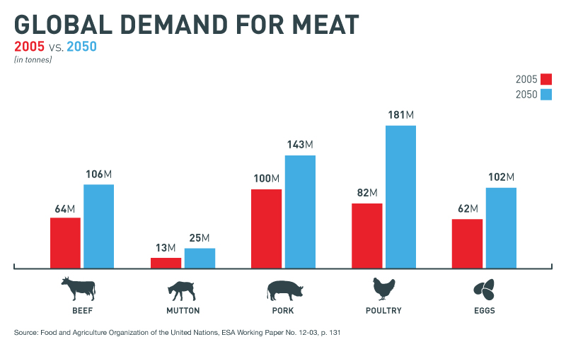
Demitarian.
What are the benefits to 1) health and 2) the environment.

Slide 5
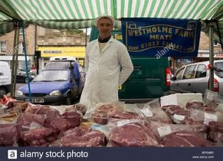
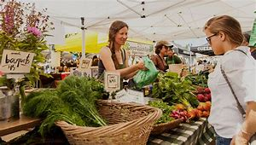
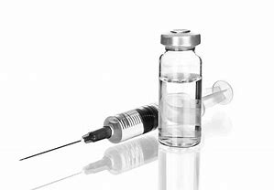
Buying local/ farmers’ markets
Is it worth paying more to buy local animal products from livestock which have been well raised and humanely slaughtered?

Slide 6
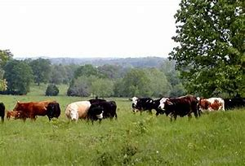
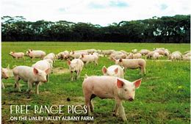
Free range livestock

Slide 7
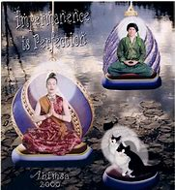
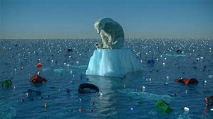
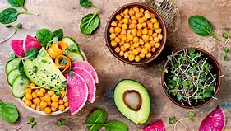
Why are so many thousands of people becoming vegan?
Veganism is a global 21st Century movement, during times when people feel anxious about climate change and animal rights issues.
Have you considered being a vegan?

Slide 8
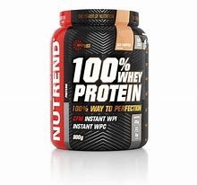
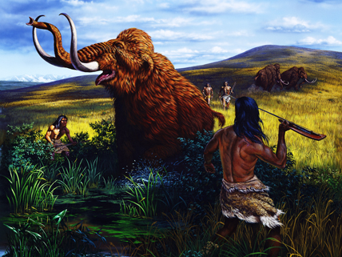
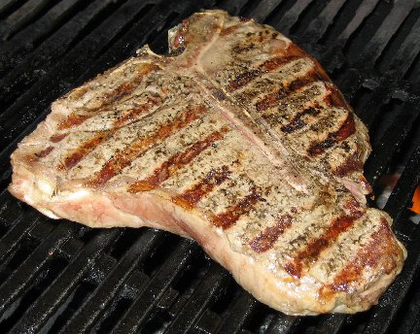
Animal Uses-Food
Meat- a source of protein
Protein is one of the five essential nutrients
Why/ When did humans start eating meat?
Hunter-gatherers.
2.5 million years ago.

Slide 9
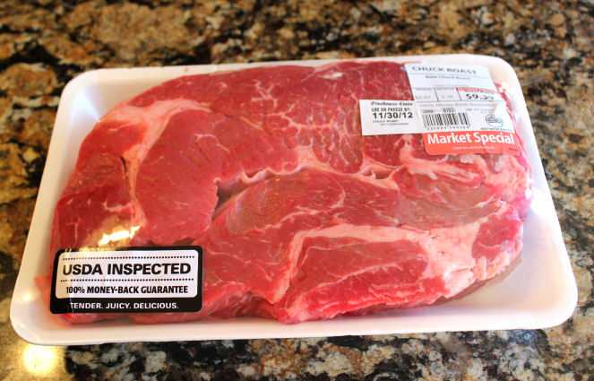
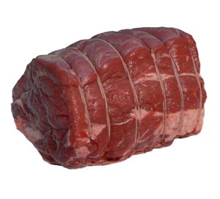
Animal Uses-Food
Meat- a source of protein
Where do you buy meat?
Do you check where it comes from?
Notes:
Meat Scavenger Hunt Activity

Slide 10
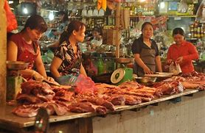
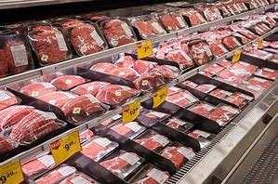
Cultural differences
Europeans try to forget they are actually eating animals.
We like to be far removed from the reality of meat.
We like to forget it is actually an animal.

Slide 11
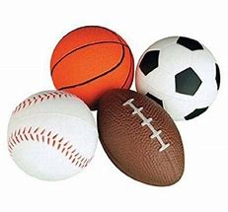
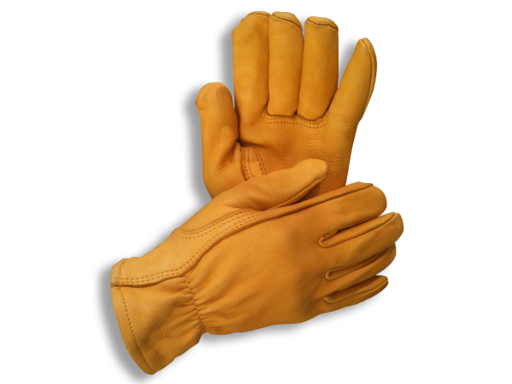
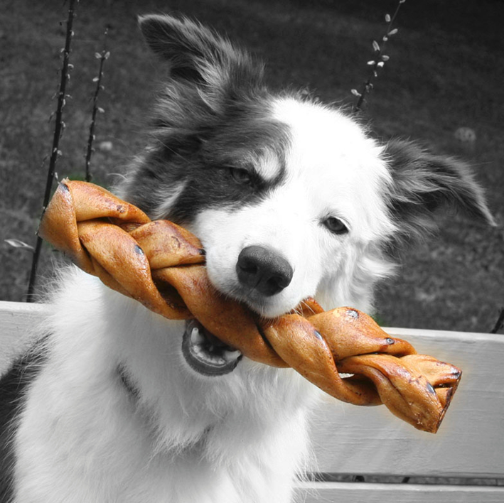
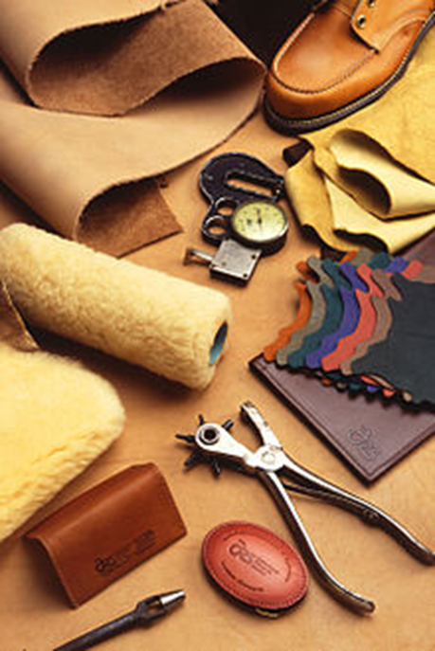
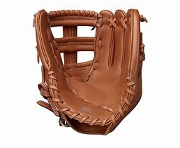
Animal Uses
Leather/ suede/fur is the skin of animals.
Hides – leather clothing, dog treats, shoes, baseball gloves, ball coverings, gloves, etc.

Slide 12
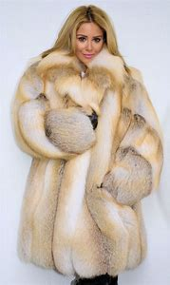
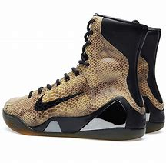
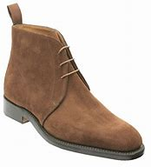
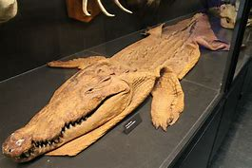
Do you use leather products?
What is an alternative to leather?
Synthetic ‘fake’ material.

Slide 13
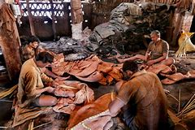
Animal Uses-Food
Is there another way to get meat and leather?
Can we sustain the amount of animals we need for these products?
Meat and Leather without killing animals
http://www.ted.com/talks/andras_forgacs_leather_and_meat_without_killing_animals.html

Slide 14
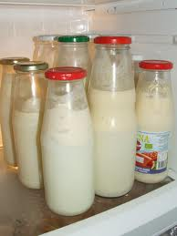
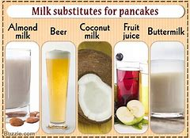
Animal Uses-Food
Milk-
a more efficient source of protein and also Calcium (Ca).
Why are teenagers choosing milk substitutes?

Slide 15
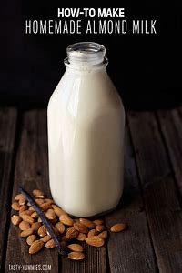
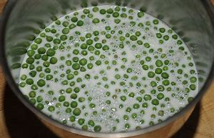
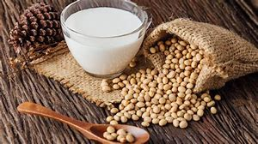
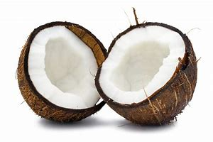
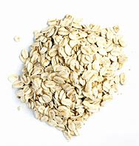
Milk substitutes.
Almond. Pea. Soy. Coconut. Oat.

Slide 16
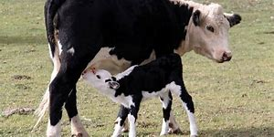
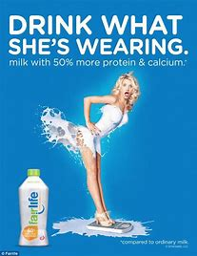
Milk is used to feed a baby cow.
Why is this necessary or natural for humans?

Slide 17
How do we use animals?
Food
Fiber/ to make textiles.
Labor
Medicine/Research
Pets/Companionship

Slide 18
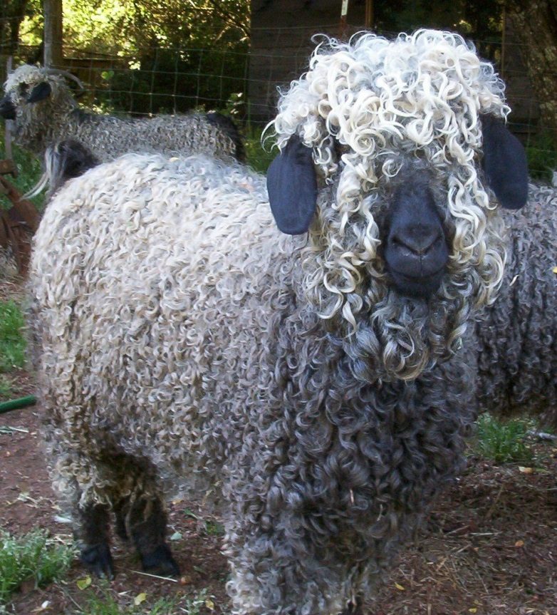
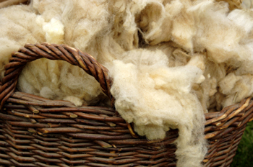
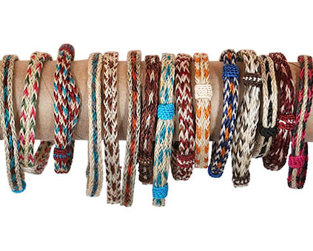
Animal Uses-fiber
Fibers - wool, mohair, horse hair, pig bristles
Clothing, tools (brushes), decoration
Wool
Horsehair bracelets
Angora Goat-mohair

Slide 19
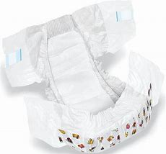
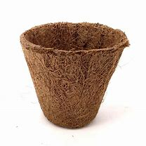
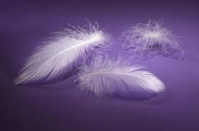
Animal Uses-feathers
Feathers- from 8 billion broiler chickens, 2-3 billion pounds of feathers.
Used for-down, decorations, diapers, filters, bedding, biodegradable plant pots, jewelry, clothing.

Slide 20
How do animals help us?
Food
Fiber
Labor
Medicine/Research
Pets/Companionship

Slide 21
Animal Uses-Labor
What are some areas in which we use/ have used animals for work?
Cultivate land
Transportation
Control other animals
Protection
Assistance
Sports competitions
recreation.

Slide 22
Animal Uses-Labor & Cultivation
Animals at Work
Debate: Should all animals have a job?

Slide 23
Animal Uses-Labor Transportation
1.Oxen and wagon
2.Dog sledding
3.Farmers
4.War-horses
5.Horse and carriage
6.Beach donkeys
7.Horse and wagon

Slide 24
8.Camels. 7.Elephants. 8.mules.
Which animal has been used primarily for royalty/ the elite?
Which animal is used primarily in Lijiang?
Which animal has always been used in hot, dry deserts?

Slide 25
Animal Uses-Labor Controlling Animals
Sheep/ Guard dog
Llamas guarding sheep.

Slide 26
Animal Uses-Labor Protection
Police Dog/ Guard-dog/ service dogs/ sniffer-dogs.

Slide 27
Animal Uses-Labor Assistance
Emotional support dogs.
Mental health therapy dogs.
Disabilities/ care support.
Hospital visitors

Slide 28
Animal Uses-Labor Assistance
Assistance/ therapy dogs

Slide 29
Fox hunting (recreation/ sports)
Hunting dogs.
Pets.
Hound-dog racing
Horseracing
Cockfighting

Slide 30
Sports
Bull fighting.
Rodeo.
Debate: It’s wrong to use animals
… in sports competitions.

Slide 31
How do animals help us?
Food
Fiber
Labor
Medicine/Research
Pets/Companionship
Spirituality/ symbolism

