Slide 1
Modern ‘wellness’/ health treatments
Mind, spirit, body.
Discuss pairs.

Slide 2
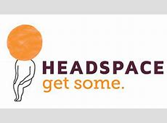
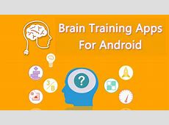
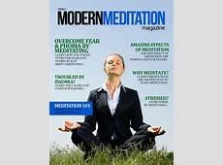
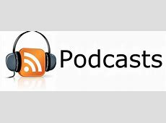
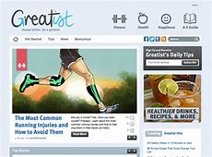
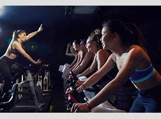
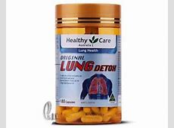
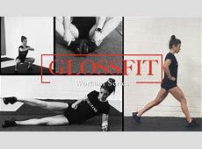
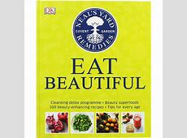
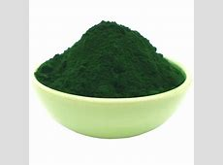
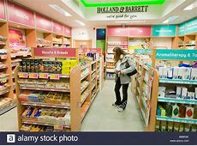
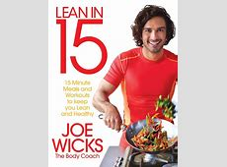
1. Students discuss. 2. Learn new words. 3. Find someone who….
1. Meditation app
2. Brain-training app
3. Health/ fitness websites
4. Health supplements
5. Social media
6. Diet-books
7. Gym-classes
8. School eating habits survey

Slide 3
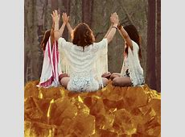
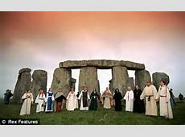
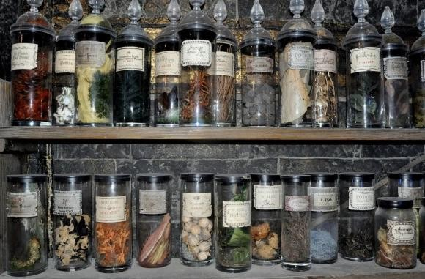
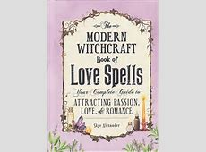
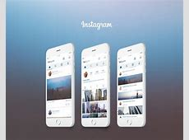
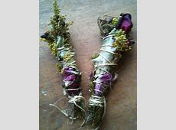
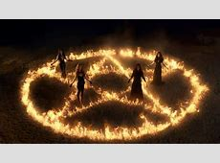
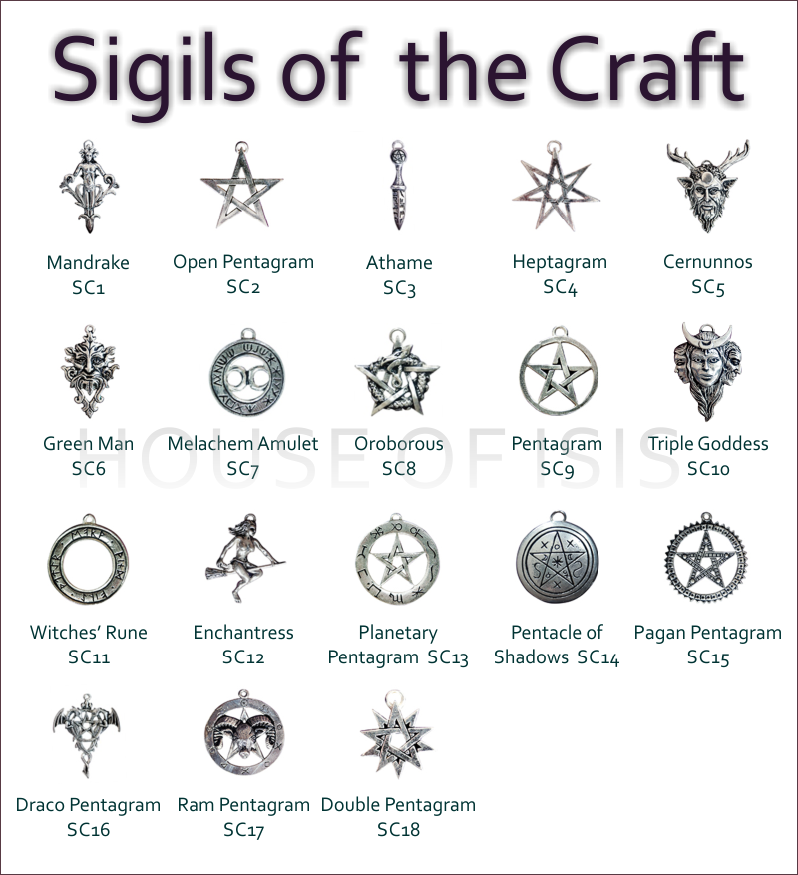
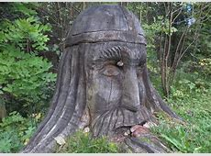
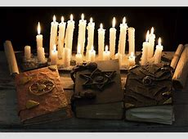
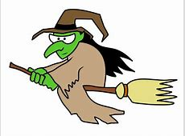
The “Wellness movement” Western culture.
Witch-craft: Wicca
Green-witch
Magick
The Occult
Paganism

Slide 4
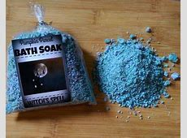
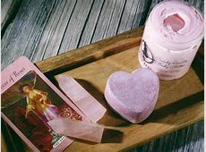
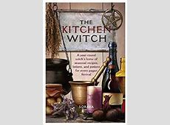
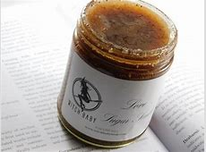
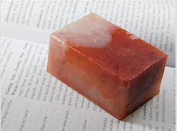
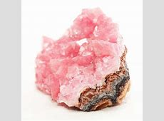
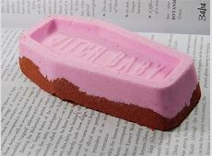
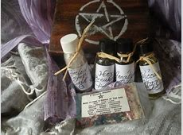
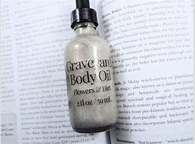
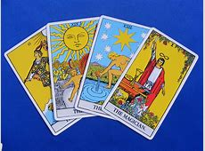
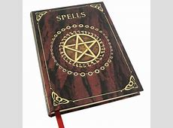
What are they?
Which would you buy?

Slide 5
Types of exercise/ workouts. 1. Watch the teacher and guess. 2. Write translations. 3. Which have you tried?
HIIT (high intensity interval training)
The treadmill
Cardio/ fat burning
Aerobics
Pilates
Hot yoga
Legs, tums and bums

Slide 6
Weight-training
PT (personal trainer)
Cycling/ spinning
Cardio-barre
Zumba
Body-combat
Dancercise.
Boxercise

Slide 7
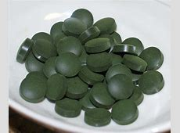
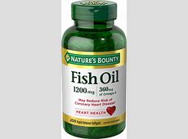
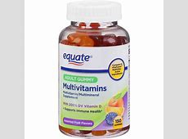
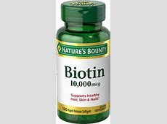
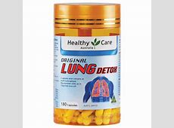
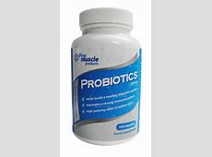
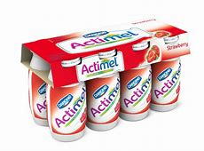
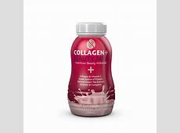
Popular health supplements
Match with benefits:
Stops hair-fall.
Good oil for the heart
Good for general health
Beneficial for the gut/ digestion.
Detoxify heavy metals- good nutrition.
Good for joints/ bones and beauty.

Slide 8
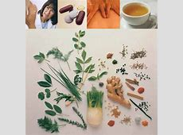
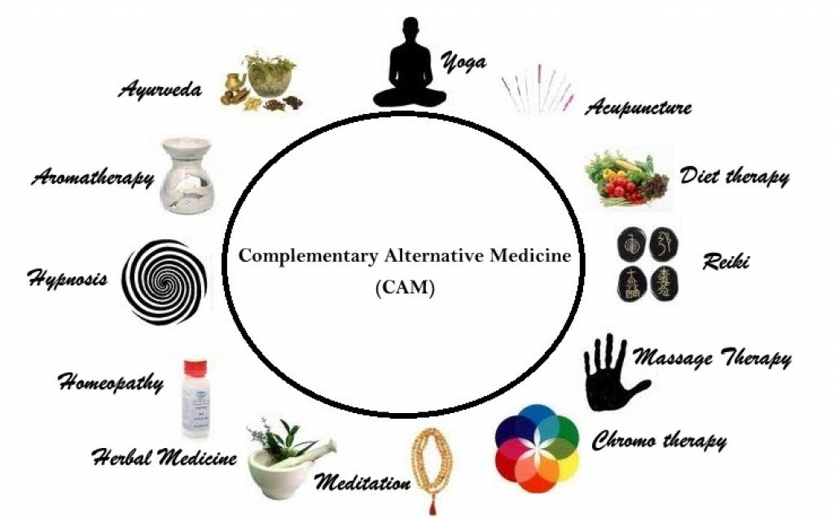
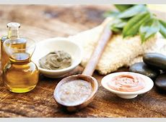
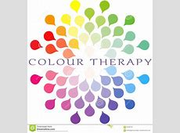
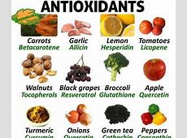
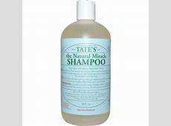
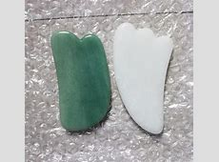
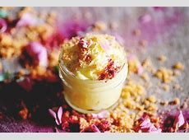
Holistic therapies for natural health.

Slide 9
Conventional medicine vs. holistic health: Let’s list pros & cons of
both.
Conventional medicine
Holistic health treatments
CONS
PROS
CONS
PROS
effective (fast solution). …………….convenient. addictive dependent overdose. Harmful chemicals. Synthetic (false). Can be poisonous. Cost-effective. Expensive- self-indulgent. Time-wasting. Need professional advice/ guidance. Scientific research. Heavy funding. Widely available. Lack of scientific evidence. Lack of funding. Traditional. Lazy. Empowering. Nurturing/ gentle. Spiritual.

Slide 10
1.Discover meanings.2. Place into pro/ con lists.3. Share in 2 groups.
Pros
Cons

Slide 11
Half of students write name on paper and sit with new partners. Discussion: 1. Holistic vs. conventional. What is the general opinion of your country?
2. Share your friends’/ relatives’ opinions.
3. Share your personal experience.

Slide 12
I’m sure so many people in China believe in traditional Chinese herbal medicine. This is because it has a strong reputation in Chinese culture. Of course, this is nothing new; it’s historically been practiced for centuries. Also, I see many Chinese people prefer holistic therapies, especially massage, yoga and acupuncture.
My grandparents do enjoy holistic therapies, especially herbal medicine, meditation, supplements and oils. However, they usually rely on conventional medicines as pharmacies are so widely available in the city. Also, they are very effective and offer fast solutions to health problems.
Personally, I can see that holistic therapies are much more natural. Without harmful, synthetic chemicals, this must be more nurturing to the body and spirit. However, holistic therapies do not have a lot of scientific evidence to support them.

Slide 13
Debate: Team A & B. A= Holistic therapies. B = conventional medicines
Sit face to face (opposites).
Use language of debate to argue in favor of your case.
I suppose that’s true, but….
Yes, you have a point there, but…
What do you think?
Do you agree?
If you ask me….
☹ I beg to differ
I’d say the opposite!

Slide 14
Let’s recap: Organize the words into wellness categories: MIND. BODY. SPIRIT.
Meditation- health supplements- body oils- work-outs- brain-trainer apps-podcasts- travel- magick/ The Occult- diet books- fitness-websites- candles- yoga – food surveys- herbs – colour therapy- antioxidants.
MIND:
Candles
meditation
SPIRIT:
Yoga
BODY:
Health- supplements

Slide 15
Health benefits of natural oils/ products. Guess the health/ beauty benefit for each:
Hair – castor/ neem/ marula/ sweet almond (oils)
Skin – moringa/ jojoba/ olive/ essential oil/ avocado/ Epson salts
Skin body butters – Buruti/ shea/ cocoa/ mango/ nut.
Mental health/ clarity: Essential oils.
Mind- Incense sticks/ candles/ ambient music (playlists). 、
Mucus/infection- menthol essential oils/ compress/ tiger balm
Mary’s recommendation: TYCHO.

Slide 16
Essential oils.
Lavender
Frankincense.
Citrus (lemon/ orange)
Menthol (peppermint)
Juniper
Rose (Bulgarian)
Jojoba, coconut, olive, sesame-seed, sweet almond, grape seed, carrot-oil, moringa, marula.
Action: We must DILUTE the essential oil in a carrier oil. Why?

Slide 17
inhale/ burn/ massage/ compress/ blend/ oil-pulling.
Anything else?

Slide 18
Workshops. Tutorials. Spas. Korean Jimjilbangs. Hot Springs. Hotels. Resorts. Independent shops. Community centers. Gyms. At-home parties. Personalized service. Mobile therapist. Massage parlors. Holistic health centers. At home businesses. Small businesses. Online memberships. Art studios.

Slide 19
Here are 7 alternative/ holistic therapy treatment: Where can we find services?
Mingle: Write person’s name + info on Chinese holistic therapies.
2. Share and tell the location.
E.g: Cici – massage – Blind massage parlour, 32 Yuantong street; next to the Greenlake.
Anna- acupuncture – ‘Golden Lotus’ spa.

Slide 21
Crystal healing
Crystal Healing - What is it? Placed on areas of the body called "chakras." There are seven energy centers in the body.
Balance. To cleanse the person from negative energy.
People visit "crystal healers”.
Worn as jewelry. Placed in the bed or bath.
Historical practice (eastern cultures).
Now popular in western culture – witchcraft/ Paganism.
The crystals have vibration frequencies to connect and balance earth's and the person’s energy field (cosmic energy).
To protect it from the environment: salt water or salt.

Slide 22
Find someone who…
1) Owns crystals
2) Wants to own a crystal collection (have many crystals).
3) Believes in crystal therapy.
Define meanings: Look back to answer.
Crystal healer
Vibration frequency
Balance
Chakras
Paganism
connection

Slide 23
Sound baths
Can range from 10 to 40 bowls with different sound notes for chakras.
Tibetan singing bowls.
Calm your breathing.
Drink lots of water. Sound waves carry on water.
Have a clear intention. (Love?)
Health benefits of meditation: Undisputable. ☺
Researchers have found that sound waves affect the human nervous system and decrease blood pressure more than traditional meditation.
Reduce anxiety. Enhance moods.

Slide 24
Switch pairs.
What would you wear?
What would be your intention?
Sound baths are great for……………………………..
You are a sound bath practioner.
Give some advice to a new client. “ You should...”

Slide 25
Floating water baths
Calm the mind, body and spirit.
Lying on your back; warm water infused with Epsom salt.
Buoyancy of the body.
Anti-gravity benefits: reduced pressure points.
Increases blood flow for natural dopamine (pleasure) ☺ and lowers cortisol (stress).☹
The sensation of where the water and your body are one, leaving you euphoric.

Slide 26
Word check: Guess the orange words: anti gravity
Buoyancy
Dopamine
Cortisol
Infused
Euphoric
Blood flow
Sensation

Slide 27
Ayurvedic dry eye treatment
The use of honey, triphala powder, ghee butter, castor oil or flaxseed oil may also benefit (natural products).
Ayurveda historically treats various eye problems: cataract, glaucoma, dry eye syndrome, and macular degeneration.
Strengthens and improves eyesight.
No longer depend on eye- drops.
Rejuvenates and nourishes the eyes to the core.

Slide 28
MINGLE: If you had dry eyes, what would you do? If you had a serious condition would you trust Ayurveda?

Slide 29
Cryotherapy
Cold therapy, low temperature.
Treats a variety of tissue lesions.^{[1]}
Cryosurgery: Destroys abnormal/ diseased tissue; treats skin conditions.
Relieves muscle pain, sprains and swelling after damage or surgery.
Can apply ice packs or have ice baths and cold chambers.
Is widely used, but little scientific evidence/ studies.
We don’t know the long term side effects.

Slide 30
When have you used cold therapy?
Is DIY better? Debate. Professional vs. DIY.
Match pics: skin lesion, sprains, swelling, puffiness.

Slide 31
Reiki
Reiki (霊気, /ˈreɪkiː/) Alternative/ holistic medicine called energy healing. A pseudoscience.
palmhealing; a “cosmic energy" is given for emotional or physical healing.
Effective for depression, anxiety.
It is based on qi ("chi"), a Universal life force.
Clinical research has not shown it to be effective as a treatment for any medical condition.^{[2]}
The American Cancer Society/ Cancer Research UK stated that reiki should not replace conventional cancer treatment.
Developed in Japan in 1922 by Mikao Usui it has been adapted into global cultural traditions.

Slide 32
List some situations where Reiki can help people.
E.g, Divorce, depression, low self- esteem.

Slide 33
Smash studio
Letting off some steam.
Born in the USA in the recession of 2008.
The earth is full of people with stressful careers.
“Traffic, job, your boss; everybody gets angry. I just saw it as a way to release that”
Slogan: “Relaxation after devastation”.
Pay more money to smash larger objects/ items/ rooms.
It’s inappropriate (not allowed) to express anger in public.
Many people think there’s never a good time to express anger and it’s never healthy but anger helps us in certain situations.”
Effective? Good for a short-term thrill.
Not genuinely useful form of anger management because it does not solve underlying issues.

Slide 34
When there is less money in an economy this is a........................
When we do things in public to make others uncomfortable, this is...................... behaviour.
When we are too busy this can feel very........................
The real reason that I have anger is the ....................... Issue
When i feel temporarily better, this is a ...........................
Vote: Open in KM?

Slide 35
Mental health therapy/ counselling/ a shrink

Slide 36
What is stigma? Shame?
US culture: Very open. Normal.
UK. Mental health week. Free NHS treatments.
Mind charity shops.
Write: How can we protect our mental health? Share ideas.

Slide 37
Types of massage.
Sports massage
Blind massage.
Full body Swedish
Neck, back and shoulder
Indian head massage
Pregnancy
Body scrub/ exfoliation
Hot stone
Aromatherapy
Thai-massage
Reflexology

Slide 38
Roleplay: At the spa.
Spa receptionist. Customer.
Ask for:
Price, length of time, products used, music/ facilities.
Ask for discount/ change the time.
Book appointment.
Do you agree a monthly massage is essential for health maintenance?

Slide 39
In the spa house.
Sauna (herbal)
Jacuzzi
Cold water pool
Hot water pools
Herbal water pools
Charcoal steam rooms
Fire steaming rooms
Jade stone rooms
Hot herbal detox
Body scrub
Mud pack
Oxygen room
Hot stones room

Slide 40
Activity: Spa consultant and a potential client.
Introduce client to the facilities.
Guide them on a tour.
Client must ask questions/ prices/ show interest.
Will you book or not?

Slide 41
Match the therapy with the treatment
Off loading mental health problems and worries.
Chakra (body energy) healing
Relaxation with ambient sounds
Body treatment with cold ice.
Ghee butter to moisten the eyes.
Floating in a pod for relaxation
Balance cosmic energy in the body.
To release stress and anger.
Mental health counsellor/ therapist
Reiki healing sessions
Sound bath
Cyrotherapy (ice therapy)
Ayurvedic dry eye treatment
Float pods/ centres
Crystal gem healing.
Smash studio/ therapy.

Slide 42
Global spa houses (around the world) Guess the country…

Slide 43
Turkey, Middle East, USA, Canada, UK, Austria, South America, Scandinavia, Japan. What adjectives can we use? Extravagant. Opulent. Indulgent. Costly. Exotic. How are spa houses different due to culture?: Service. Decor. Treatments. Nudity.

Slide 44
Match these problems with the pics:
Saggy/loose skin
A bitter divorce
Workaholic (high stress)
A fat, lazy slob
Depression
Hay fever/ allergies
Role-play activity: In pairs (A & B): Describe your problem and ask for/ give advice from a wellness therapist.

Slide 45
My wife says Im a fat lazy slob. I have no energy. After work I just eat snacks and watch TV. What can I do?
Well, I really think you should take more exercise. Join a local gym class and get a PT to motivate you. You should also see the doctor because it sounds like you are depressed. I suggest you try alternative medicine such as Reiki. This helps to balance energy in your body so you can focus on positive changes.
My skin is loose and saggy now that I am 65 and I lost some weight. How can I get make it better?
Have you heard about.......? It can........

Slide 46
1) Write down a list of treatments. 2) Write a student’s name for Yes, No.
Which treatment is the most/ least popular? Why?

Slide 47
Discuss: Which treatments can be helpful to your life? Which would you NEVER try? Why?
Writing activity.

Slide 48
Budget-friendly wellness

Slide 49
Visual revision. Match words to pictures.
Cymbals. Sound bowls. Spiritual healer. Wellness centre. Holistic products. Chakras. Floating. Wellness website. Wellness trends. Emotions. Body pain. Green juice/ smoothie. Food processor/ blender. Health supplements.

Slide 50
Debate: Wellness treatments are essential for optimal (excellent) health ☺ vs a waste of time and money ☹ Two teams sit opposite and debate.
For
Against
Calming/ relaxing
Relieve stress (stress relief)
‘Me’ time
Luxurious
Self-care
Life is too busy
Self- indulgent
Too expensive
Lack of scientific evidence
Bunch of ‘hippies’

Slide 51
Expressions for Agreeing and Disagreeing
Stating an opinion
The way I see it...
If you want my honest opinion....
As far as I'm concerned...
If you ask me...
Asking for an opinion
What are your thoughts on all of this?
How do you feel about that?
What do you think?
Do you agree?
Expressing agreement.
I agree with you 100 percent.
I couldn't agree with you more.
That's so true.
You're absolutely right.
Absolutely.
Exactly.
No doubt about it.
(agree with negative statement) Me neither.
(weak) I suppose so./I guess so.
You have a point there.
Expressing disagreement
I don't think so.
(strong) No way!
I'm afraid I disagree.
(strong) I totally disagree.
I beg to differ.
(strong) I'd say the exact opposite.
Not necessarily.
That's not always true.
That's not always the case.
No, I'm not so sure about that.

Slide 52
Use English….
Check out gokunming.com for wellness centers.
Post questions to the gokm online community. Price/ reviews/ recommendations.
Write online reviews for the website listings.
Which treatment do you plan? Which was the best and worst treatment you had?

Slide 53
What are the chinese equivalents?
Acupuncture.
Traditional Chinese herbs
Blind massage.
Yoga
Guided meditation centers.
Feng shui
Gua sha
Tai chi
Fire cupping

Slide 54
Match the words to pictures
Acupuncture.
Traditional Chinese herbs
Blind massage.
Yoga
Guided meditation Gua sha
Tai chi
Fire cupping

Slide 55
Western vs Eastern wellness treatments
Differences
Similarities

Slide 56
Wellness retreats/ options

Slide 57
Activity: You are tired and stressed. You have one week free time. Plan a weekly schedule of wellness treatments. Compare with partner.
Mon | Tues | Weds | Thurs | Fri | Sat | Sun
Yoga class Nature walk Acupuncture

Slide 58
Creative project: In groups of 4, design the perfect wellness retreat. Name. Services. Facilities. Location. Food or refreshments. Packages/ Prices. Check other adverts. Choose a retreat.

