Slide 1
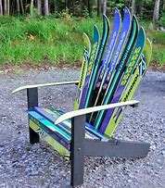
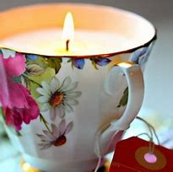
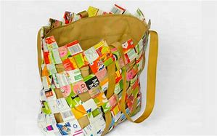
Up cycling/ recycling ideas and inspiration.
Turned into…
A convenient shopping bag
A decorative candle
A park bench
What items were up cycled?
Old pairs of skis
Old magazines.
Tea cups

Slide 2
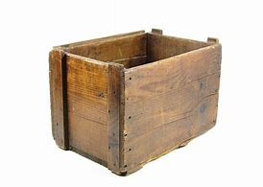
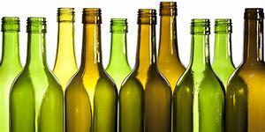
Define: up cycling.
To repurpose old, potentially waste or useless materials so they have an enhanced, valuable use and purpose.
How would you up cycle…. Old wine bottles/ an old crate?
Students 1-4. Find your groups. Share your ideas together. Agree on the best idea. Return to your original groups and present your idea.

Slide 3
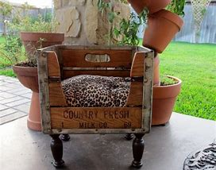
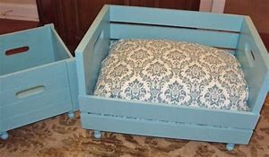
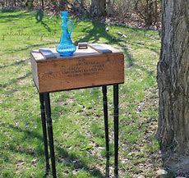
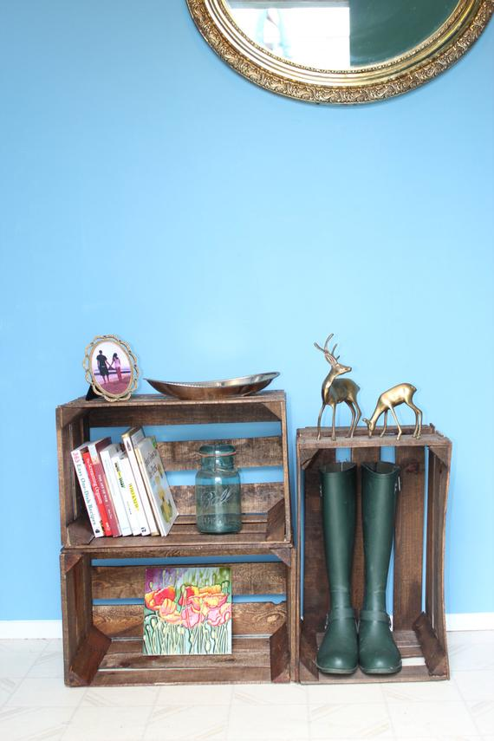
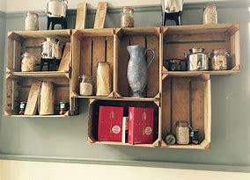
Some innovative/ exemplary/ imaginative/ ingenious creations.
A pet’s bed
Wall shelves
A comfortable chair
A book/ boot fixture
A side table

Slide 4
How are up cycled items aesthetically pleasing?
Rustic/ charming/ evoking/ nostalgic.
Timeless quality
Handmade
A personal touch
Unique/ quirky/ stylish
Quaint
Surprising/ unexpected/ thought provoking/ bonkers
Impressive
Respectful/ thoughtful
Wholesome
Characterful
Awesome/ original/ amazing.

Slide 5
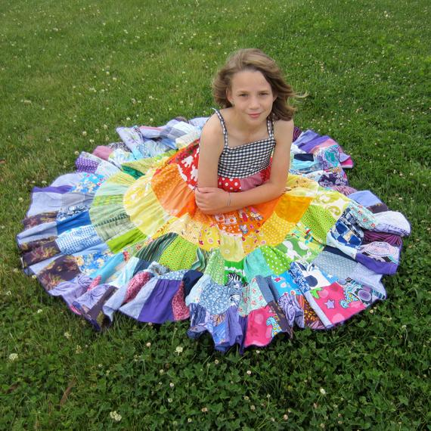
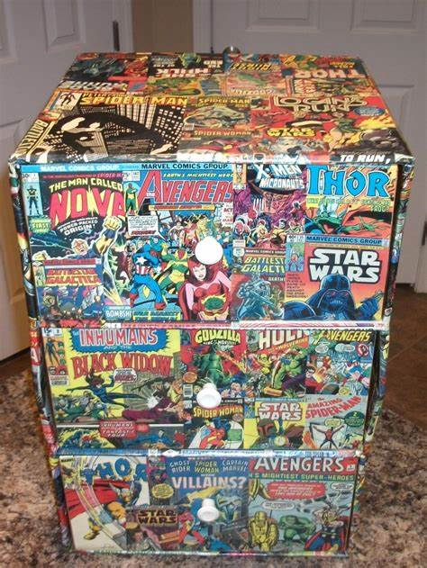
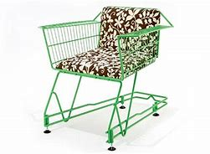
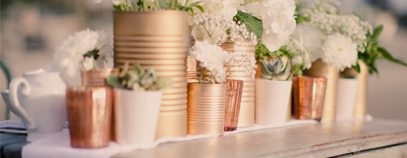
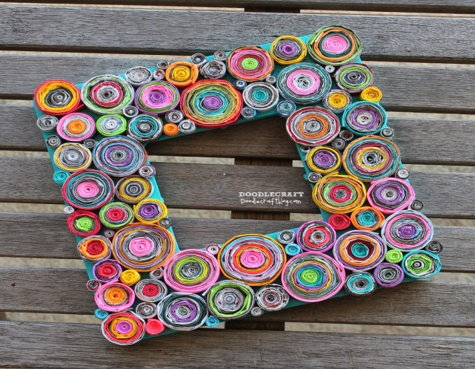
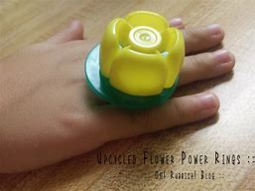
Activity: Look at the items; choose a word to describe your appreciation. Find the adjectives on the wall.

Slide 6
How would you recycle….

Slide 7
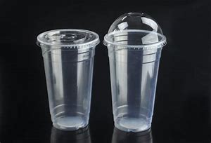
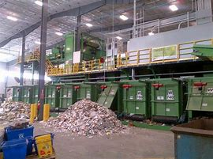
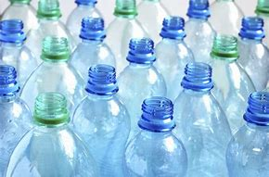
Define: Recycling.
Simply taking valuable/ natural materials to a local center to be sent to a processing/ recycling center to (ideally) be used again, in the same form and for the original purpose.

Slide 8
Interviews:
Make your own questions.
Where..?
How often..?
What..?
Why (not)…?
When…?
Listen & take notes. (A & B) A and B group together. Discuss which student recycles the most. Feedback.

Slide 9
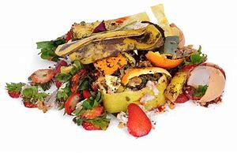
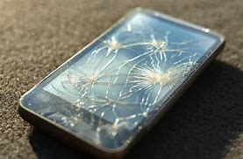
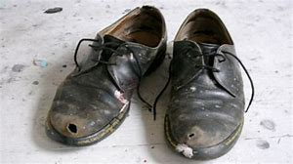
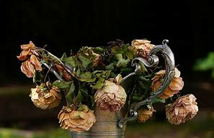
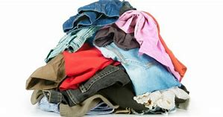
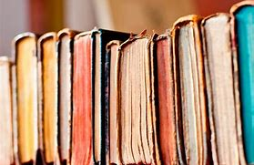
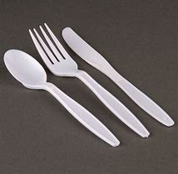
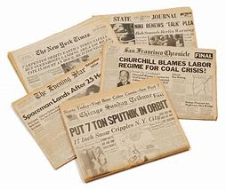
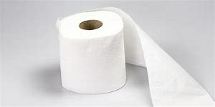
Recyclable materials or not?
Pairs: Face to face. (A & B) Describe the waste materials. B= say if recyclable or not + how to complete this action. A compare with own views and agree/disagree/ suggest.

Slide 10
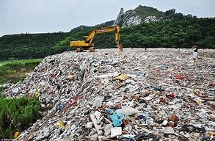
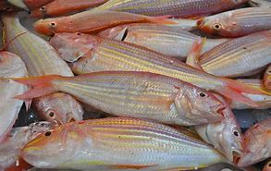
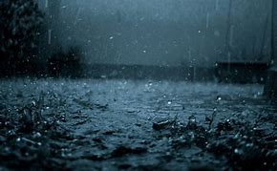
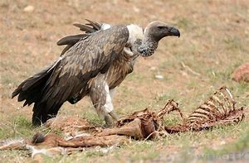
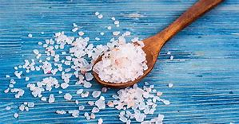
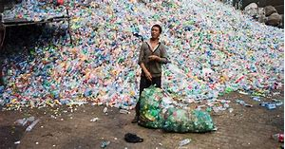
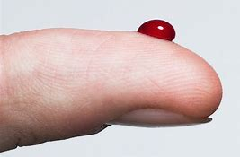
Why is recycling more important than we think?
‘scavenger’s’ income/ lifeline.
Thousands of illegal landfill sites centered around every city.

Slide 11
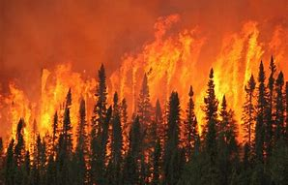
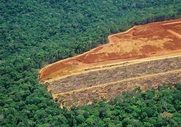
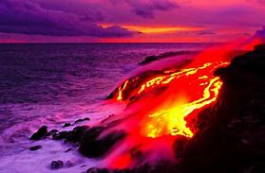
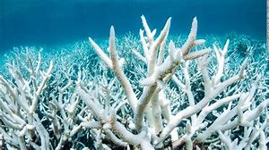
Discuss/ match the problems of not recycling…
Mass forest fires (due to increased temperatures)
Deforestation for billions of new paper products
Warming of the ocean: coral bleaching
But… the ocean absorbs of most of C02/ heat from the sun to moderate earth’s temperature.

Slide 12
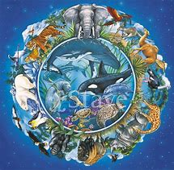
Don’t forget
It’s the circle of life…
We are all connected. Humans/we ARE nature; we aren’t separate from it. We depend on nature. Nature works in synergy; it is cyclical. If one part becomes broken, it will affect us all.

Slide 13
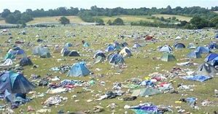
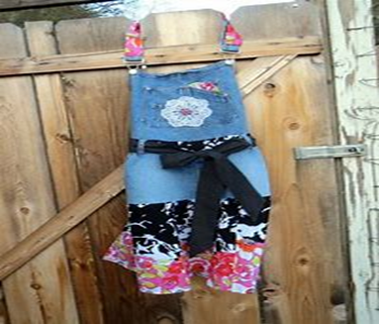
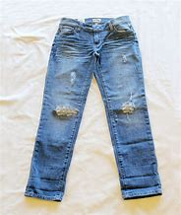
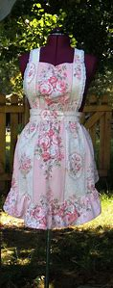
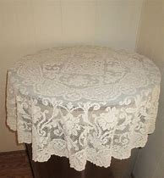
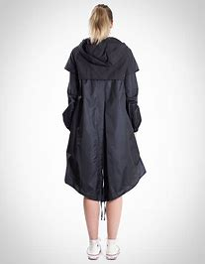
So how can we up cycle waste materials? Match materials + new items
Discarded tents
Old pair of jeans
Old table cloth
Waterproof anorak
House-work aprons

Slide 14
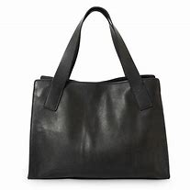
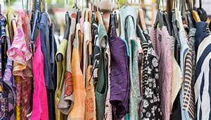
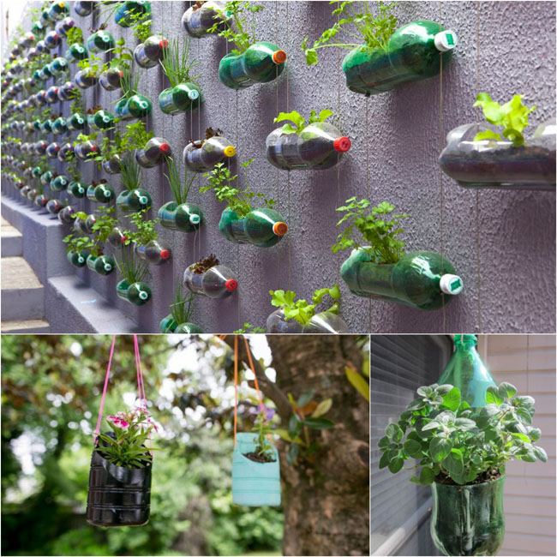
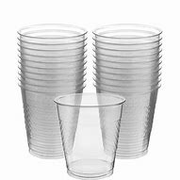
Rubber tires
Ugly/ vile clothing
Disposable cups/ bottles
Plant/ herb pots
Quilts
Handbags and accessories.

Slide 15
So it’s time to get creative….
How can you avoid disposing of….
Activity: Jigsaw. Discuss ideas with the same numbers. Come back to groups and teach other students.

