Slide 1
Haughty. Optimistic. Pessemistic. Rude. Astute. Charismatic. Empathetic. Cocky. Fierce. Fearless. Conscientious. Self absorbed. Uptight. Ignorant.
These are adjectives to describe someone’s character.

Slide 2
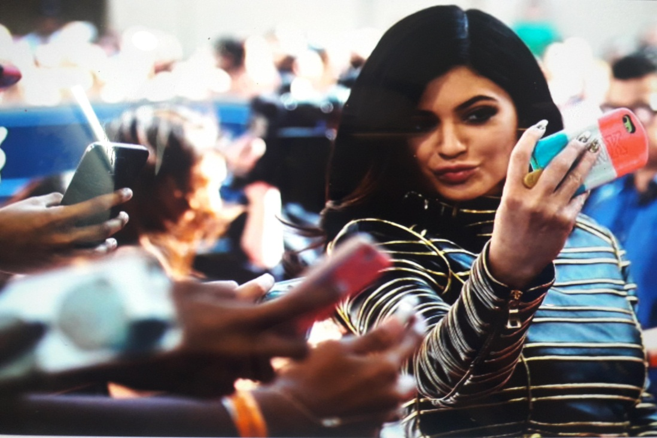
Looking down nose. Unfriendly hard face Ignores others
Taking a selfie
Pouting lips
Not looking at anyone else
Checking her mirror
She is....
She is....

Slide 3
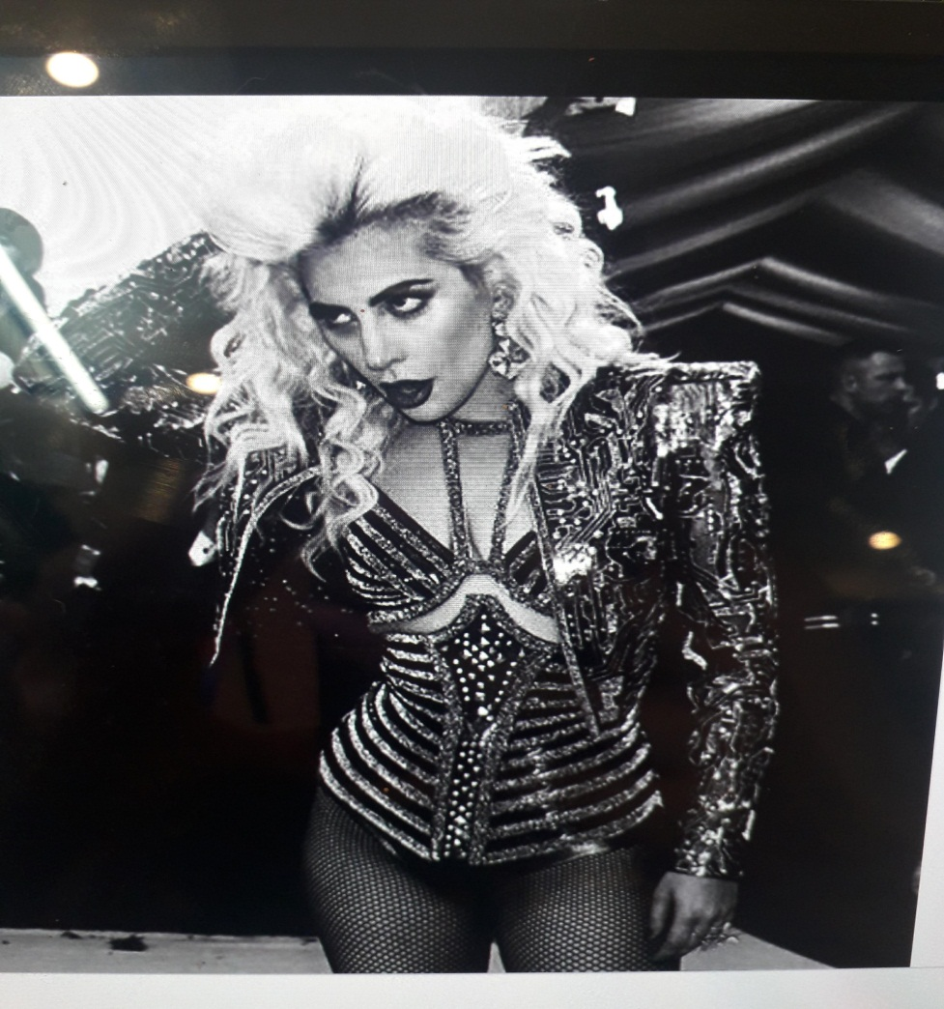
Popular. Throwing/ hosting a party excellent social skills well dressed and handsome and charming
Bold outfit
Striking a pose
Creative/ ‘avant guard’ style
Confident/ self assured

Slide 4
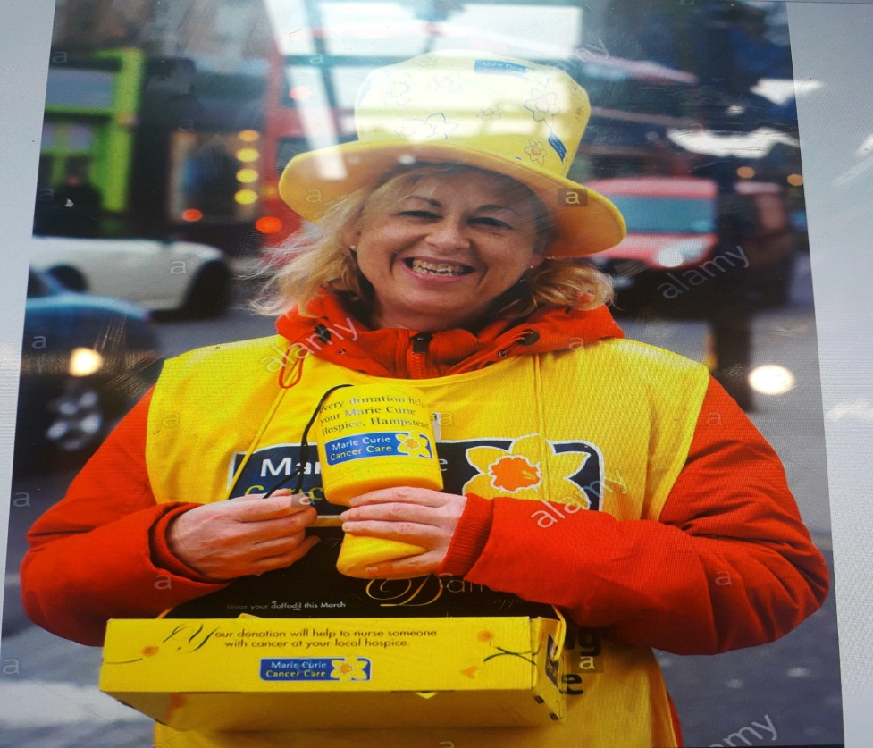
Joyful/ light/ happy comfortable outside positive thinking gratitude
Fundraising for charity
Thinking of other people
Working/ giving time to help others

Slide 5
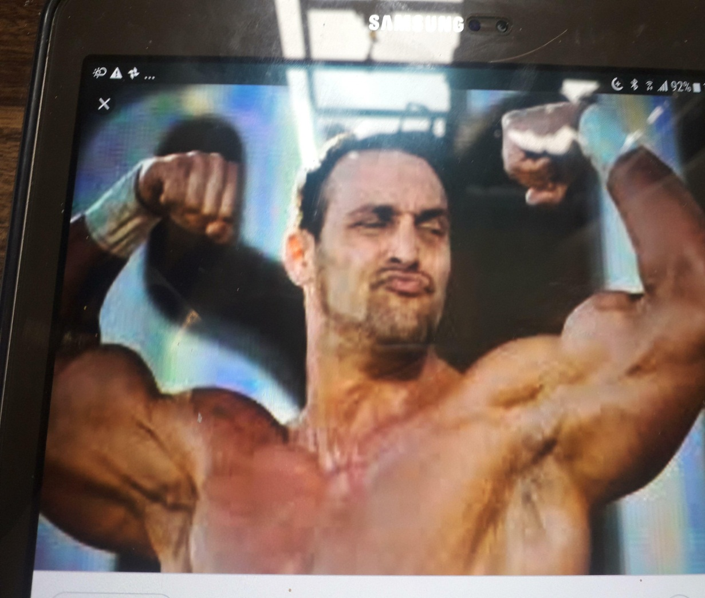
Not listening do not care do not want to know ‘Who are you?”
I am the best
Everybody loves me
I am better than you
‘Kiss my ass’

Slide 6
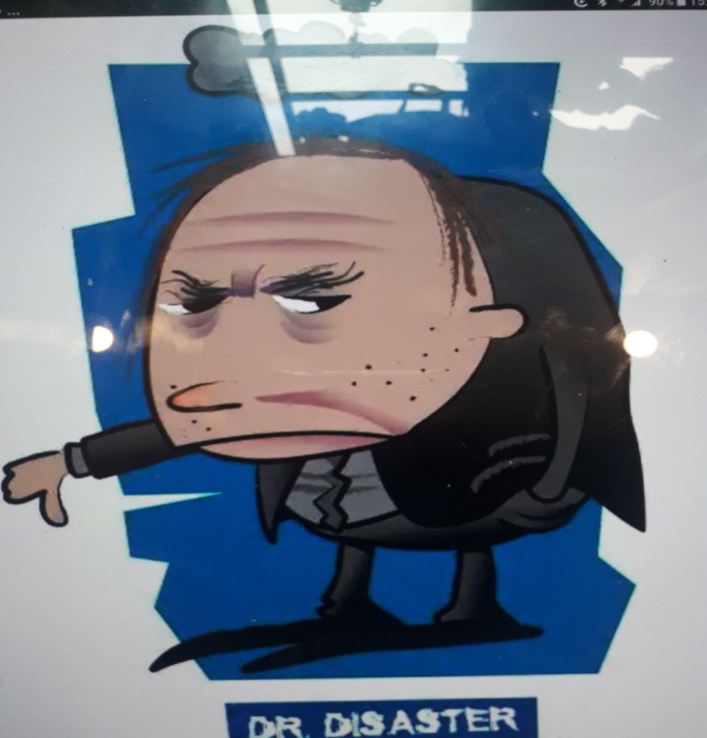
Angry with other people easily irritated hardly ever smiles Easily finds faults with others. Takes everything too seriously.
It is always raining on me…
Always grumpy
Everything is terrible.
Sees the worst case scenarios.
Doesn’t like people.

Slide 7
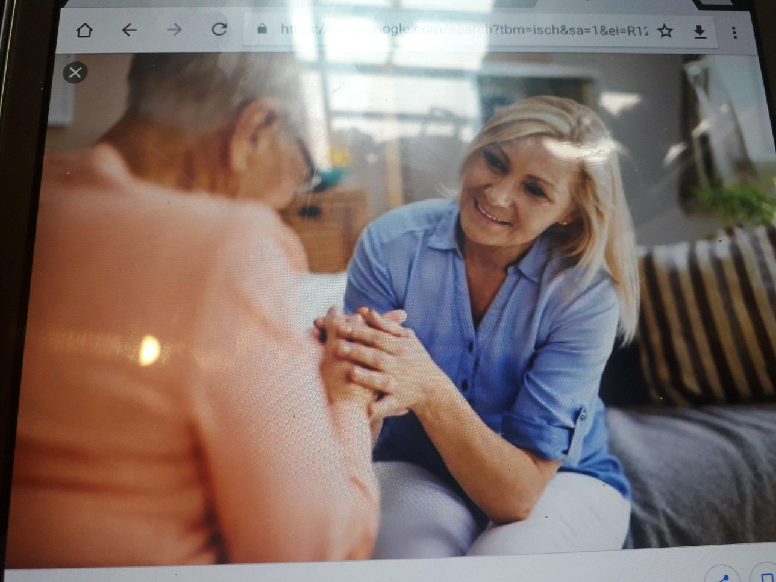
I love my yoga job exercise everyday meet lots of people positivity and core strength spirituality way of life.
Cares for the elderly
Provides genuine support
Warm hearted/ heart felt
A good listener
Respectful and considerate

Slide 8
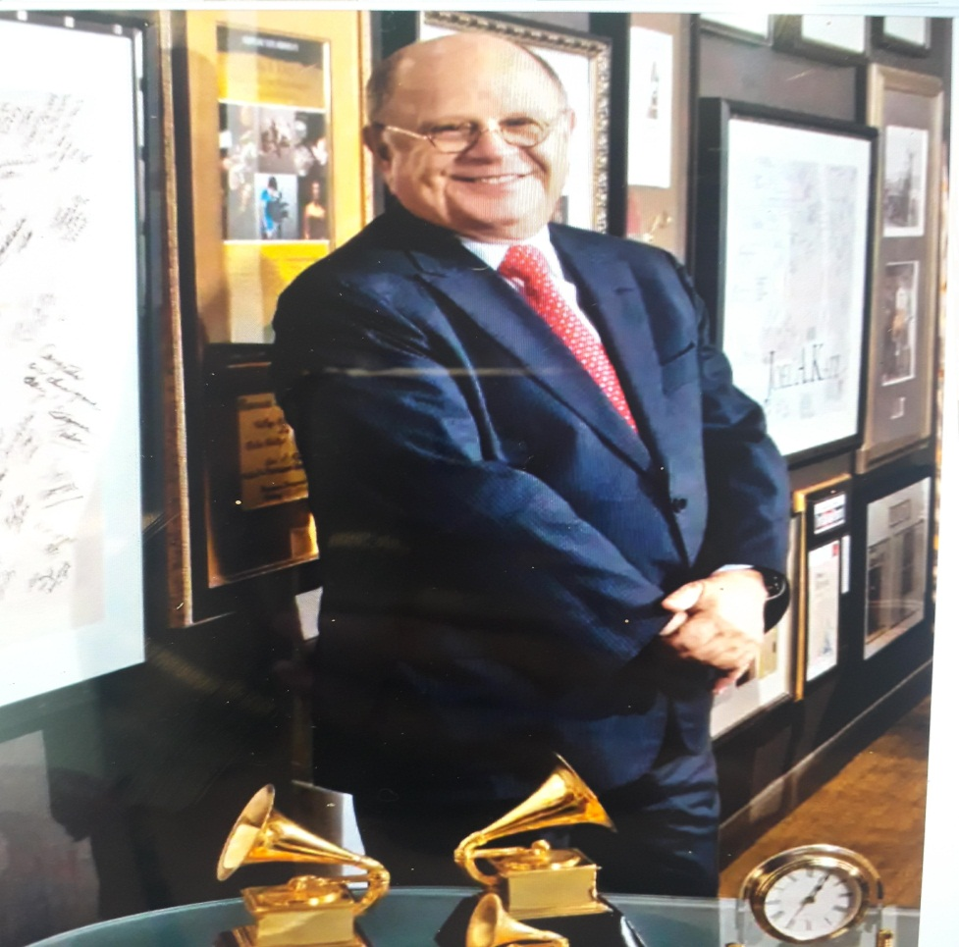
Shouting at strangers do not care for other’s feelings foul language (cursing) frighten/ intimidates others
Clever/ high IQ.
Proud
Well-off/ wealthy
Academic achievement/ certification
A ‘do-gooder’

Slide 9
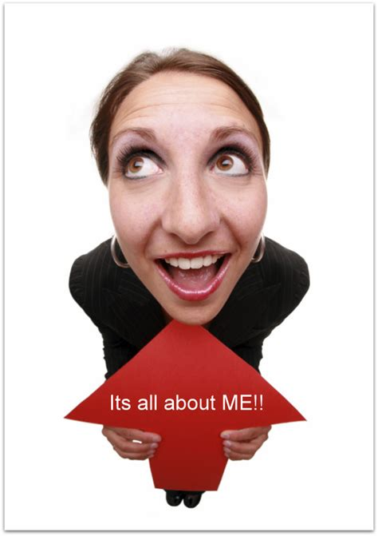
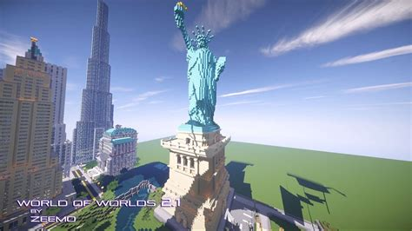
Writing: How would you describe your character?
I must say that I think I am a considerate, conscientious person. I care about other’s feelings and try not to hurt people with my words and actions. I must admit, sometimes I can be self absorbed as I think about myself too much. I feel like the whole world revolves around me. I try to be fearless and not worry too much. I hope I can be more optimistic because I know the world is a wonderful place!

Slide 10
Hands up if you are (characteristic).
Activity: Charades.
Hand out worksheet.
Mingle: Ask all students and write a student’s name next to each adjective. “Do you think you can be…?”
E.g: Optimistic: Dennis
Fierce: Sunny
Self absorbed: Mary

Slide 11
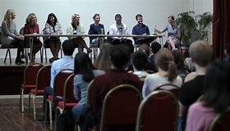
Panel discussion.
We will record a new podcast episode, titled:
1. How can we make work environments more successful?
Key words: Nurturing/ supportive/ anti-bullying/ polite manners.
2. Discuss: What are the best and worst qualities to have? Why? E.g. ‘I think it’s the worst to be cocky and arrogant because this is not very considerate of others feelings. However a little bit of arrogance can be attractive.

Slide 12
Language of debate
As far as Im concerned...
I strongly feel that..
If it were up to me...
Im convinced that...
Wouldnt you agree that...
Without a doubt...
I suspect that...
The way I see it...
Id like to point out that....

Slide 13
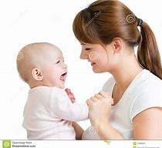
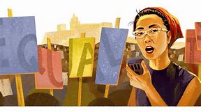
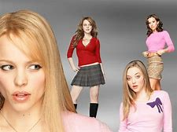
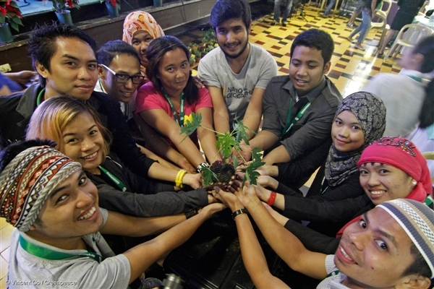
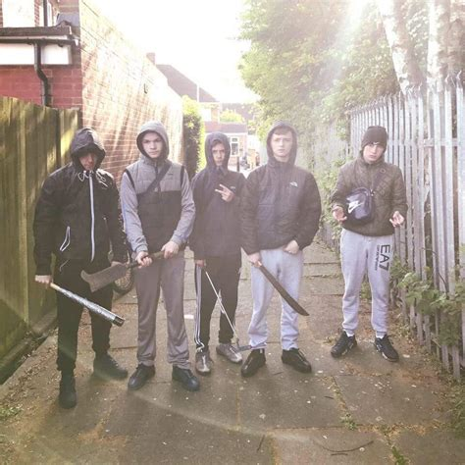
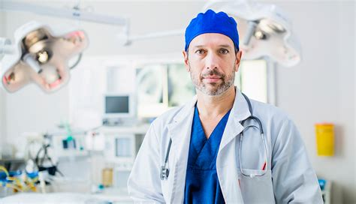
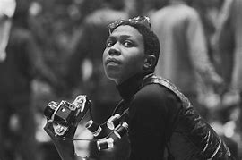
What adjectives would you use to describe these people? (Let’s be judgmental!) General presumptions.

Slide 14
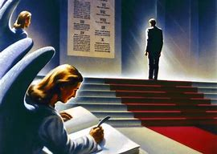
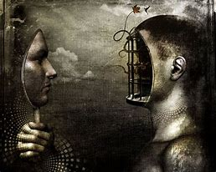
“ Never judge a book by its cover”.
Why is it so hard to pass judgments of other people’s characters?
What is meant by “things are not always as they seem”.
What is an ‘illusion’ and ‘perception’?
When is it ok to make a judgment?

