Slide 1
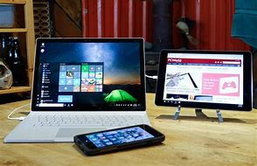
Internet & PC slang & modern words.

Slide 2
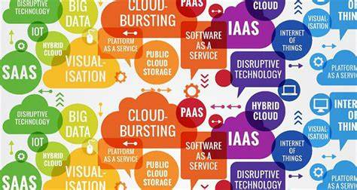
Buzzword/ phrase
A specific word/ phrase which gains temporary popularity and is used by many people at once.

Slide 3
Examples
‘That’s what she said’
‘Internet of things’
‘cloud computing’
‘amazeballs’

Slide 4
The practice of storing computer data on multiple servers that can be accessed through the Internet. E.g. One Drive.
A thing which is assigned an IP address with the ability to transfer data via a network without the need for human interaction.
A sexual euphemism.

Slide 5
Can you translate popular buzzwords from Chinese into English?
Write on squares. Stick on wall. Students walk around and translate.

Slide 6
Tribal/ viral marketing
Using social media and analysing social behaviour to promote products.

Slide 7
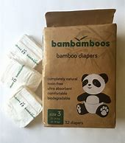
How can you use social media to promote…

Slide 8
Netiquette
Language of courtesy and appropriateness when communicating with online communities.

Slide 9
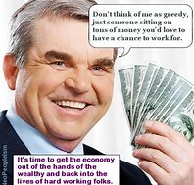
Appropriate or not? Listening activity: Stand up. Take pen & notebook. A & B (opposites).B read 4 x sentences. A write down APPROPRIATE/ INAPPROPRIATE. Switch places & repeat.
Hey Mr. Watson, Are u gonna give me A* cos I’m ur fave student innit.
I hope you don’t take offence; I’m not keen on this style, but it looks good on you.
Wow, I loved watching your video. Thanks for creating this!
Western Europe has stronger economies because they are greedier people.

Slide 10
Vietnamese people eat dogs because Asians don’t like animals.
I have visited Korea and from what I gather, women love beauty but don’t want to pay top prices for products. At least that was my impression.
You look cheap and common in this photo.
India has a history of just 2000 years. They make up the rest.

Slide 11
Now A & B group together (2 x circles).
Debate why you perceive it to be rude or polite.

Slide 13
Co-creating ideas with the customer.

Slide 14
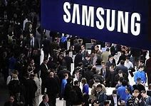
Crowdsourcing examples.
Samsung
Samsung has the largest Crowdsourcing facility. They seek innovative solutions for electronic products and technologies. They look for collaboration with other firms and individuals.
They offer users the chance to help create the company’s next product and earn a share of revenue along the way.

Slide 16
How would you crowdsource..?
Greenpeace.org ads.
Air B n B

Slide 17
Debate: Crowdsourcing an authentic means of production vs it is just stealing other people’s ideas for self- benefit.

Slide 18
A favourable piece of publicity, such as a celebrity endorsement, interview or article to advertise a new product.
Plug

Slide 19
What kind of marketing most influences you to buy a new product? Why?
Celebrity endorsements
An article
An interview with the creator
An visual advertisement
Word of mouth
other
Activity: Stand up, mingle. Find similarity groups & discuss why (take notes) & share with class.

Slide 20
Buzzworthy
A piece of information, idea, event or product which is perceived as being worthy of much attention.
What are buzzworthy things in China?
Do you pay attention to the hype or not?
Do you know about new information earlier or later?
Hype: Simulated and often exaggerated claims of mass excitement surrounding the release of new products or materials for the public.

Slide 21
“1 sold every minute”
‘Glastonbury tickets sold out online, within 25 minutes’
New skincare range sold out within days.
New prints of book, as they have all sold out.
Due to popular demand, we have created new courses.
We have thousands of emails per day.
Do you believe the hype or not? Real or psychological manipulation?

Slide 22
Copy left
The opposite of copy write. This eliminates restrictions on distribution.
What materials/ goods/ sources can you access for free?
Is anything really free?

Slide 23
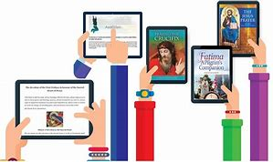
Vook
A combo of video, text, image and social streams in an e book.
Being instantly communicable via multiple devices with internet or mobile phone access.
Hyperconnected

Slide 24
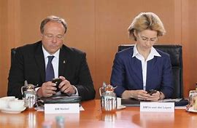
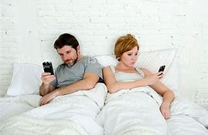
Give advice for these hyperconnected people:

Slide 25
Language of courtesy and appropriateness when communicating with online communities.
Being instantly communicable via multiple devices with internet or mobile phone access.
The opposite of copy write. This eliminates restrictions on distribution.
A combo of video, text, image and social streams in an e book.
Using social media and analysing social behaviour to promote products. Encouraging mass sharing online so information spreads quickly and on a large scale.
Copyleft
Vook
Hyperconnected
Tribal/ viral
marketing
Netiquette

Slide 26
Simulated and often exaggerated claims of mass excitement surrounding the release of new products or materials for the public.
A favourable piece of publicity, such as a celebrity endorsement, interview or article to advertise a new product.
A specific word which gains temporary popularity and is used by many people at once.
A piece of information, idea, event or product which is perceived as being worthy of much attention.
Plug
Hype
Buzzworthy
Buzzword

Slide 27
Activity. Matching race.
2 x teams, group together & race to match words & meanings. Stick on wall.

Slide 28
Game: Hot Seat.
2 x teams. 2 x students from each team sit on 2x chairs. Team members must explain the key words. The most points, wins!

Slide 29
Team 1
Team 2
Copyleft Vook

Slide 30
Plug Hype

Slide 31
Buzzworthy
Buzzword

Slide 32
Hyperconnected Tribal/ viral marketing

Slide 33
Netiquette

Slide 34
Text speak
Oh my god
Laugh out loud
Question for you
Talk to you later
Later
Great!
Birthday.
Thanks!
Be right back.
By the way
See you
As soon as possible
At the moment
Got to go
Wait
How are you?
Joke

Slide 35
Activity: 1) Take handout/ translate.
2) Groups of 3/4 stand up (circles). Use a slang word to continue convo. If can’t, sit down.
Last student standing, wins.
…………..
‘Omg, I’m having the best time!’
The beach is so gr8….

Slide 36
Congratulations, you have ventured (…) into the English-speaking environment of the Net.
The Web is full of constantly evolving (…) colloquial (…) expressions that are very difficult to understand.
You must face(…) the problem. I hope to help you in this quest (…)
Adjective = developing
verb=to enter
verb=to confront
adjective=slang
noun=search

Slide 38
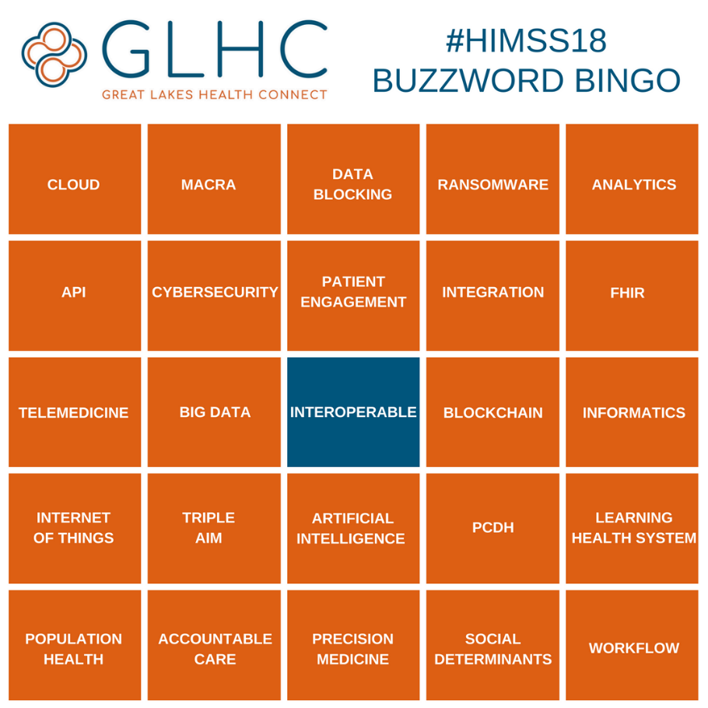

Slide 39
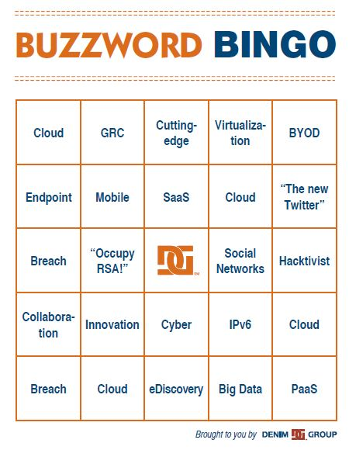

Slide 40
Phrasal verb=to look at/ noun phrase=not in relationship to something/ verb=to get accustomed to
Help is available with many vocab lists on the Internet to teach PC vocab for you to check out (…) While vocab lists are good, they are still out of context (…).
What would help is an article written with some of the slang included - and defined - in order for you to get the feel of (…) this new kind of vocab...

Slide 41
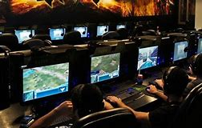
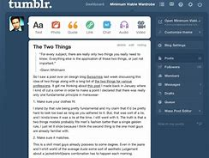
The Adventures of Delmon
Imagine you see Del the Avatar () on Wechat. Here is what she says:
...So, I was out surfing the Web. You know, lurking in a MUD, reading my favorite e-zines, and I met this grrrl on google hangouts. We both blabbed away, talking about her homepage and how many hits it got.

Slide 42
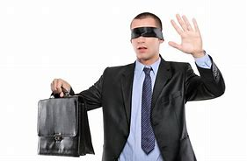
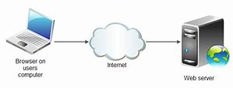
….The next thing you know, this newbie logs on and starts to ask us questions like "What's the difference between a server and a provider?", "Do I have to pay for shareware?"

Slide 43
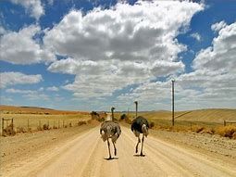
…and "Are you really there, or are you a bot?". It was OK for awhile as I am into Netiquette and all that. Luckily, he hit the road and we could continue our gab.

Slide 44
Let's take a look at what the avatar said in a more simplified form…..

Slide 45
...So, I was out surfing the Web (…) You know, lurking (…) in a MUD (…) and , reading my favorite e-zines (…), and I met this grrrl…
spending time using the Internet
being in an interactive environment without typing anything
Multi-user dungeon, where many people gather to play games, have discussions, study…
similar to a magazine, an e-zine is "published" on the Internet
verb = to browse the internet
a female internet user
visitors to the webpage.

Slide 46
We both blabbed (…) away, talking about her homepage (…) and how many hits (…) it got. The next thing you know, this newbie (…) logs on (…) and starts to ask us questions like "What's the difference between a server (….)
Talked
a person's private page on the Internet
visits by other Web users
someone new to the Internet
enters the chat area
the computer that provides the space for homepages and other Internet addresses

Slide 47
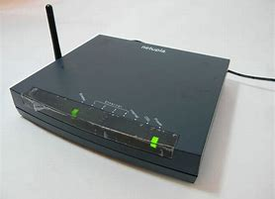
the time it takes to get something from the Net onto your computer
the amount of data a connection is able to transfer
to flow slowly, usually used with water
the hardware used to connect to the Net
Anyway, we started talking about download times and bandwidth. She said she thought that the speed would never improve -- it just took so long for something to trickle through her modem.

Slide 48
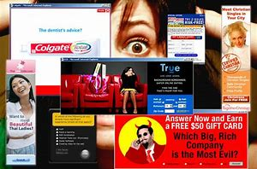
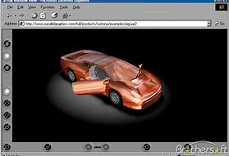
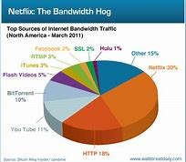
I told her that one of the frustrating things about the Net was when I got into VRML and it was such a bandwidth hog that I went to sleep just waiting for it to pop-up on my tube...
a 3D kind of Internet page
a page or program that requires a lot of data to be downloaded before use
Appear
computer monitor or screen

Slide 49
…and a provider (…)?", "Do I have to pay for shareware (…)?" and “…Are you really there, or…”
the service that provides the connection from your home to the Internet
software available on the Internet for download and free use for a limited time before buying

Slide 50
are you a bot (…)?". It was OK for awhile, as I am into Netiquette (…) and all that. Luckily, he hit the road (…) and we could continue our gab (…).
a kind of software that performs a certain task on a Network
being polite on the Net
left
discussion.

Slide 51
Well, I hope that explains things! As you have noticed, there is a whole new set of vocab to be learned when using the Internet.
Some words are slang. Some are standard.

Slide 52
Would you like to know what IT geek and nerd mean?
Well, they are both terms that describe someone who loves the technical side of any situation (obviously, the Internet is full of them!).
They have become quite in demand these days as everyone needs someone to help out with the computer!

Slide 53
Create qus.
Activity: Outside-inside circle. Ask question & move to the right.
Service provider?
Pop-ups?
Gab?
Download times
Surf
E-zine
Hits
E.g. ‘How many/ much…/ How do you..?/ improve..? Which websites do you like to…./ What/ why/ Where…?

Slide 54
Gamification
You are Bing’s CEO. How can you apply this principle to improve employees work performances?

Slide 55
3D/ 4D printing
Has 3D printing become essential in schools/ businesses/ personal lives?

Slide 56
5G/ HUAWEI
The connection and interaction between hardware, software and the user. They communicate together.

Slide 57
Debate: 5G good or bad?
Pros & cons.
Radiation towers
A much higher frequency
Totally advanced technology

Slide 58
Does social media need to integrate more haptics?
Haptics
The use of the sense of touch, especially in social interactions or in interfaces between humans and computers.

Slide 59
Humanoid robots
Activity: Would you buy a robot?
What for?
Debate: Should robots replace workers in factories/ companies?

Slide 60
Factory labor/ heavy machinery/ street vendors/ cashiers/ teachers/ self-driving cars

Slide 61
Crypto currency
Bitcoin
Cyber – insurance
Essential or not?
Trustworthy?
Mainstream?
Digital money
Free of government control

Slide 62
Virtual reality
Algorithm

Slide 63
Digital revolution
Commercial drones

Slide 64
Start ups
Screenager

Slide 65
Spinnish
Spin-doctor
Spiel
(Words carefully orchestrated to persuade).
Sofalise

Slide 66
Staycation
Trigger warning

Slide 67
Netizen
Netpicker

Slide 68
Optics
Outernet

Slide 69
Paywall
Hactivist

Slide 70
Flash mob
Freemale

Slide 71
Flexitarian/
Demitarian
E-piracy

Slide 72
E-cruitment
E-lancer

Slide 73
E-waste
Cyber-slacking/ loafing

Slide 74
Crowdfunding
Clickbait

Slide 75
Click and collect
captcha

Slide 76
Alternative media
catfish

Slide 77
Troll
Binge watch

Slide 78
Trojan virus
Malware
Spyware
Black swan

