Slide 1
Idioms

Slide 2
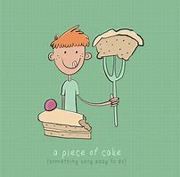
What is an idiom?
An idiom is an expression with the following features:
1. It is fixed and is recognized by native speakers. You cannot make up your own!
2. It uses language in a non-literal - metaphorical - way.

Slide 3
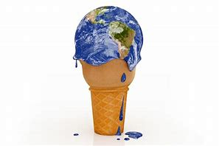
What is a metaphor?
Metaphors not only help people describe and make sense of their lives, but can serve as a source of encouragement, motivation, or gratitude.

Slide 4
mEnurageentco
Mivonotati
Grtidetua
Spelling bee game.
Stand up.
Add the letter or sit down.

Slide 6
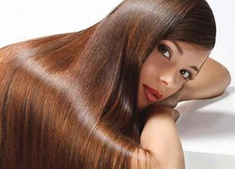
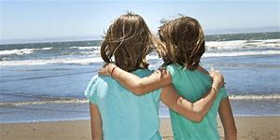

Slide 7
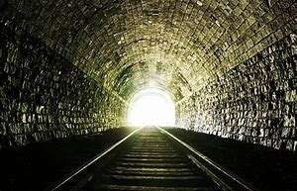
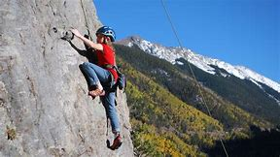
If you are facing a challenge, a metaphor might help you see the big picture and give you strength; for example, someone going through cancer treatment/ depression may view the journey as climbing a mountain.

Slide 8
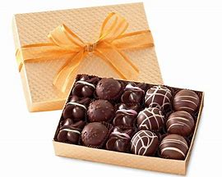
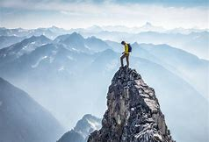
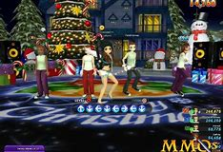
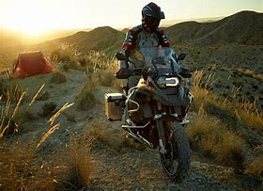
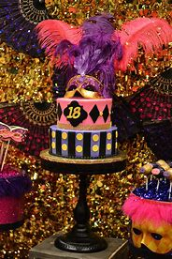
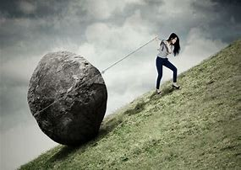
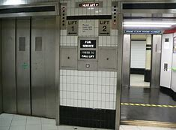
Good mental health includes having life metaphors that help you see the big picture of your life.

Slide 9
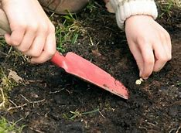
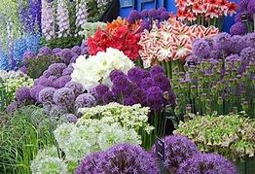
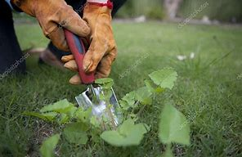
A Garden
If you see a garden as a metaphor for your life, you may see that relationships with family and friends can be cultivated like flowers or vegetables.

Slide 10
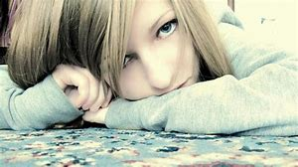
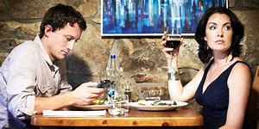
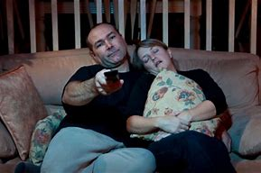
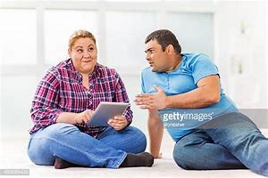
Relationships, like flowers, need regular watering. They need sunshine. Sometimes they need to be pruned. Sometimes you need to weed the garden (eliminate toxic friends).

Slide 11
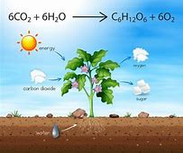
The end result can lead to plants (or relationships) which are growing, producing oxygen that help you breathe, and create beauty as they flower.

Slide 12
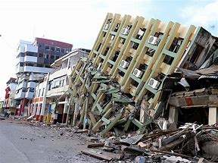
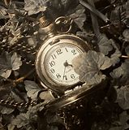
A Building
A building is a solid metaphor for life and can be a reminder that a sturdy foundation is needed before building higher.
Once you have a firm foundation in place, it's easier to confidently add floors and rooms which will stand the test of time and weather.

Slide 13
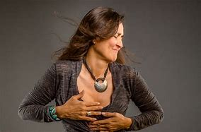
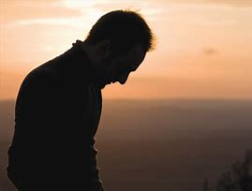
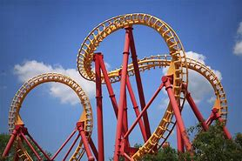
A Roller Coaster
A roller coaster can be a metaphor to describe the speed bumps we all encounter.
You don't fully experience the high points of your journey without the contrast of the lows.

Slide 14
How has your life been/ is your life a rollercoaster?
How can we make the rollercoaster a safer ride?
Precautions
Cautiousness
Safety protection.

Slide 15
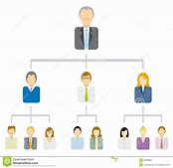
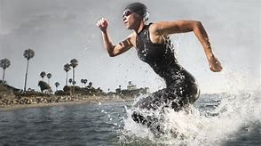
Climbing a mountain can describe our education or the steps we take in climbing the corporate ladder.
Life often consists of hierarchies.
This metaphor also illustrates that it takes hard work, determination, and sheer endurance to get where we wish to go.

Slide 16
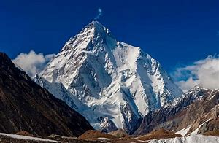
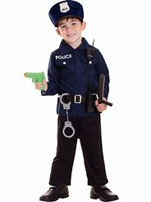
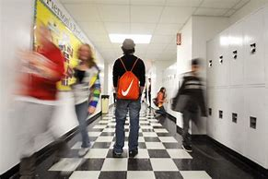
Give advice to…

Slide 17
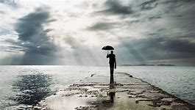
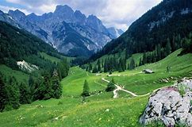
Most mountains paths are not directly uphill, but take us down through valleys to get to the next peak.
Emotional resilience allows you to follow the trail as it descends before it turns the corner and heads back up again.

Slide 18
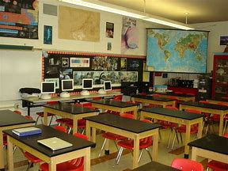
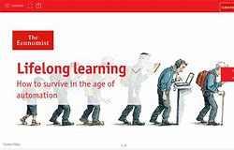
Life is a classroom in so many ways and there are always new lessons to learn no matter your age. This metaphor can be a reminder to keep your mind active and learning throughout your life.
Is life long learning achievable?
What are the best ways?

Slide 19
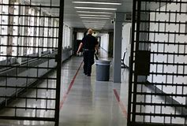
A Prison
A prison can be a metaphor for a life in which you feel out of control. You may feel like you don't have choices and that others have the power.

Slide 20
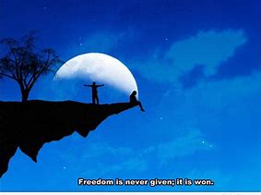
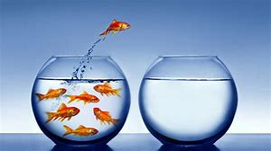
Activity. Draw a picture of what ‘freedom’ means to you. Share in small groups. Choose the best to present to class.

Slide 21
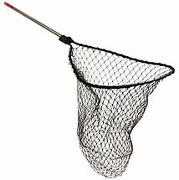
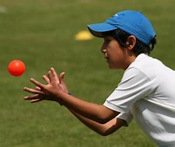
Literal & Metaphorical
Literal 文字的
I've been out fishing, but caught absolutely nothing!
Metaphorical 比喻性的
Yesterday I caught the bus.
He caught my attention.
Wait while I catch my breath!
Look at that tan! You've caught the sun!
I didn't quite catch what you said.

Slide 22
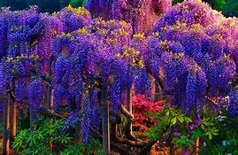
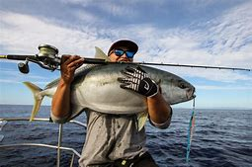
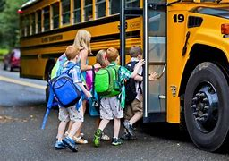
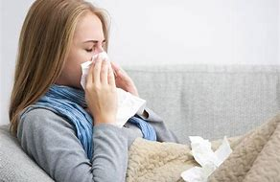
What catches your attention?
Did you catch the flu?
Literal or metaphorical?
Catch a fish. Catch a bus. Catch a ball. Catch on to a good idea. I caught a cold. Catch a thief. Catch a movie.

Slide 23
?

Slide 24
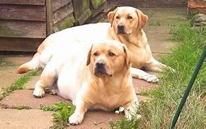
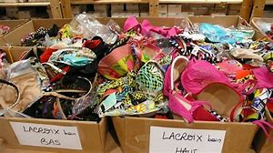
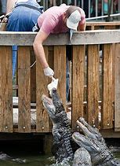
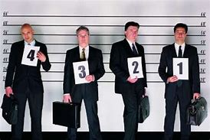
Metaphorical meanings…
I’ve lost my confidence
I picked up a few bargains
This idea will never get off the ground
What’s your side of the story?
Have you been talking about me behind my back?
Some people overfeed their dogs but it comes from a good place.

Slide 25
What is a metaphor?
Metaphors exist in all languages. You use them in your own language. A metaphor uses one idea to stand for another idea. A simple idea: A crowd is water. When you have that idea in your mind, the crowd can flow, flood, or trickle(细流）.
Here are some of the common metaphors:
1. Time is money.
We save time. We can spare 5 minutes. We can run out of time.
2. Business is war.
Advertising is a minefield in which you have targets and keep your sights on what your competitors are doing.

Slide 26
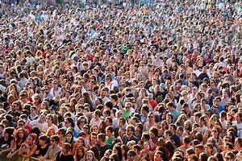
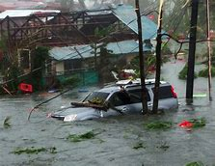
Flood/ flow/ trickle

Slide 27
Time is money
We save time. We can spare 5 minutes. We can run out of time.

Slide 28
Business is war.
Advertising is a minefield in which you have targets and keep your sights on what your competitors are doing.

Slide 30
Moods are weather
A company is a ship
Sail, float or sink

Slide 31
A person…
Bad struggles?
You can sink or swim.

Slide 32
Optimistic or pessimistic?
Life is an adventure
New days, new opportunities
Exploration
Just a bad day
Tomorrow is another
Struggle
fighting
Win or lose.

Slide 33
Life is gambling
Take a risk
Take a chance
Don’t play safe
You win some, you lose some.

Slide 34
Seeing is understanding
Life is a journey
I see your point.
I can see through her.
Can you try to see through my eyes.
Take the wrong turn
Take the right turn
Turn your life around
To be on the right/ wrong path.

Slide 35
I’m stuck in a rut.

Slide 36
A constant stream of visitors

Slide 37
Seeing is understanding
I don’t see the point
I see what you mean
I can’t see what you’re getting at.
I can see right through her.
I see clearly.
Shine a light on the situation.

Slide 39
Important metaphors
1.Time is Money
2. Business is War
3. Seeing is Understanding
4. Life is a Journey
5. Life is Gambling
6. A Company is a Ship
7. Moods are Weather
12. Crowds/people are Liquid

Slide 40
Time is Money
Literal meanings
1. I spent over ￥100 today.
2. I‘ve been trying to save at least ￥10 a week all year.
3. ￥2000 for a holiday! What a waste of money!
4. Can you spare me ￥50 for a cup of tea?
5. I could manage ￥700 a week, but I simply can‘t afford ￥100 for a flat.
6. I've run out of cash. Is there a cash machine anywhere near here?
7. Buy a second-hand car. New ones just aren't worth the money.
8. We made over a thousand pounds at our Christmas Fair.

Slide 41
Time is money
Metaphorical meaning:
a. Could you ＿＿＿＿5 minutes for a chat?
b. 40 minutes waiting for a bus! What a ＿＿＿＿of time!
c. It‘s worth ______at least two days in Oxford.
d. You‘ll have to finish now. We’ve ＿＿＿＿＿＿time.
e. I‘m busy today, but I can ＿＿＿time for you tomorrow afternoon.
f. Let‘s get a taxi. It’ll＿＿＿ at least 20 minutes.
g. Venice is definitely ＿＿＿a whole week.
h. I‘m so busy at work. I can’t ＿＿＿more than a week off at a time.

Slide 42
Time is Money
a. Could you spare 5 minutes for a chat?
b. 40 minutes waiting for a bus! What a waste of time!
c. It's worth spending at least two days in Oxford.
d. You'll have to finish now. We've run out of time.
e. I'm busy today, but I can make time for you tomorrow afternoon.
f. Let's get a taxi. It'll save at least 20 minutes.
g. Venice is definitely worth a whole week.
h. I'm so busy at work. I can't afford more than a week off at a time.

Slide 43
Seeing is understanding
We use the verb see in English to mean with our eyes, but also to mean understand. We say Seeing is believing and I see what you mean.
View/ point of view
Hindsight: understand it after it has happened
e.g. With hindsight, the world would have stopped Hitler earlier.
short-sighted
eye-opener

Slide 44
Seeing is understanding
a. see past the end of his nose
b. made myself perfectly clear
c. open your eyes
d. saw through
e. through my eyes
f. saw reason
g. eyes wide open
h. see the point

Slide 45
Seeing is understanding
a. see past the end of his nose 目光短浅
b. make myself perfectly clear 把自己的意思讲清楚
c. open your eyes 长见识
d. see through 看穿或看透
e. through my eyes 以某人的眼光
f. see reason 明白事理
g. (with one’s) eyes wide open 充分了解自己所做的事情
h. see the point 理解某人的意思

Slide 46
I think social media is amazing. Why can’t you ……………….. Of it?
He can’t…
I can ………… her ‘cute’ smile.
Have I made myself……………….. I want a d……….

Slide 47
……………….. You can totally work online.
I just don’t ………………… of Facebook.
Can you see ……………….. I need you to help my baby!
…………. To a brave new world!

Slide 48
1. Why do you want me to complain? I can't________________
2. I thought I'd________ , but I still ended up with the mushroom pizza when I ordered the ham and mushroom!
3. Try to see the situation______________ I simply can't afford
to spend £1,000 on a holiday.
4. Jane and Fred are both in their sixties so they're going into marriage with their__________________

Slide 49
5. It took a long time to persuade Pete, but he finally_______
6. My boss is really selfish and small-minded. He can't_______
7. Look, you need to change your job. They're paying you peanuts! They make you work all hours. It's time you should _______ and look for something better.
8. I knew all Justin's stories were exaggerated. I__________ him
the first time I met him.

Slide 50
1. Why do you want me to complain? I can't_ see the point _
2. I thought I'd_ made myself perfectly clear_ , but I still ended up with the mushroom pizza when I ordered the ham and mushroom!
3. Try to see the situation_ through my eyes _ I simply can't afford to spend £1,000 on a holiday.
4. Jane and Fred are both in their forties so they're going into marriage with their_ eyes wide open _
5. It took a long time to persuade Pete, but he finally__ saw reason _____
6. My boss is really selfish and small-minded. He can't_ see past the end of his nose ___
7. Look, you need to change your job. They're paying you peanuts! They make you work all hours. It's time you should_ open your eyes _ and looked for something better.
8. I knew all Justin's stories were exaggerated. I__ saw through _ him the first time I met him.

Slide 51
Went through the roof.
When…

Slide 52
The black sheep of the family.

Slide 53
On its last legs

Slide 54
Talk the hind legs off a donkey.

Slide 55
Can you translate idioms?

Slide 56
Time
for hours on end.
non-stop.
into the small hours.
b. on the dot.
or thereabouts
sharp.
in no time.
in a tick
shortly.
d. in the nick of time. just in time.
not a minute too soon.
e. from time to time.
now and again
every so often.
Which group of expressions completes the sentences below?
1. The police arrived
2. Dinner will be ready at six
3. We go to the cinema
4. They argued
5. I'll be with you

Slide 57
Time
for hours on end. 几个小时才结束
non-stop. 不停地
into the small hours.到凌晨
b. on the dot. 准点
or thereabouts 左右
sharp. 准点
in no time. 立刻，马上
in a tick（钟的滴答声）
shortly.
in the nick of time. 在紧要关头
just in time.
not a minute too soon.
e. from time to time. 偶尔
now and again 时而
every so often.
now and then
once in a while
Which group of expressions completes the sentences below?
1. The police arrived
2. Dinner will be ready at six
3. We go to the cinema
4. They argued
5. I'll be with you

Slide 58
Time
Complete the following with a phrase from the right hand column:
1. Long time a. a matter of time.
2. Tomorrow is b. on the spur of the moment.
3. It's only c. like the present.
4. We decided d. another day.
5. There's no time e. for this time of year.
6. It's very cold f. no see.

Slide 59
Time
Complete the following with a phrase from the right hand column:
1. Long time a. a matter of time.
2. Tomorrow is b. on the spur of the moment.
（凭一时冲动）
3. It's only c. like the present.
4. We decided d. another day.
5. There's no time e. for this time of year.
6. It's very cold f. no see.

Slide 60
Time
Which of the above expressions completes these situations?
Where've you been for the past six months? _____!
_________ before holidays in space will be normal.
Here's the number of ray dentist. Ring him and make an appointment. Go on,________________
What a day!___________ It's usually much milder.
We're off to Bali tomorrow__________________
Just forget everything that's happened today________________

Slide 61
Time
Which of the above expressions completes these situations?
Where've you been for the past six months? _Long time no see____!
_It’s only a matter of time________ before holidays in space will be normal.
Here's the number of ray dentist. Ring him and make an appointment. Go on, _ there’s no time like the present______
What a day!__ It’s very cold for this time of year___ It's usually much milder.
We're off to Bali tomorrow __ we decided on the spur of the moment_____
Just forget everything that's happened today __ tomorrow is another day______

Slide 62
Time
a. at the last minute
b. in due course
c. once in a blue moon
d. at the crack of dawn
e. for donkeys' years
f. at the eleventh hour
g. in this day and age
h. sooner or later
i. not in a month of Sundays
1. very early in the morning
2. not for a very long time
3. very rarely
4. never
5. in modern times
6. eventually
7. almost too late

Slide 63
Time
a. at the last minute
b. in due course 及时的
c. once in a blue moon
d. at the crack of dawn
e. for donkeys' years
f. at the eleventh hour
g. in this day and age
h. sooner or later
i. not in a month of Sundays
1. very early in the morning
2. for a very long time
3. very rarely
4. never
5. in modern times
6. Eventually 最后
7. almost too late

Slide 64
Now use the expressions in the following situations:
1. We arrived on the platform at the very __________, just as they were closing the doors.
2. I can't believe there are so many homeless people ______________. The government should do something about it.
3. When I'm on holiday and the weather's good, I love to get up_____________
4. I haven't seen my Uncle Roger__________________ He lives in Spain now.
5. I have always found that if you really want something and put your mind to it, you get it___________

Slide 65
6.1 wouldn't be seen dead in a zoo -________ ! I hate the very idea of the places.
7. I'm never early, and I'm never late, but I do admit to doing things______
8. This company has a policy of always replying to complaints. Every single complaint is dealt with carefully and a reply is sent___________
9. Although Jill lives on the other side of the road, we only ever see her_______________

Slide 66
Some more common idioms…
To spill the beans.

Slide 67
Get off my back!
Marriage? Money? Job? Weight? Diet?

Slide 68
We were in stitches!
When was the last time you were in stitches?

Slide 69
She was dressed to kill
What are the advantages?

Slide 70
I’m at the end of my rope!
Give metaphorical support to troubled people:
(Activity: Inside –outside circle).
Overworked father.
Stressed out student.
A person with ill health.

Slide 71
You have to bite the bullet

Slide 72
Money talks

Slide 73
Teachers always stick to their guns
Does everyone stick to their guns?

Slide 74
bent over backwards

Slide 75
Activity. Listen to teacher’s description. Walk to the correct idiom on the wall. Say it back to me in convo.
E.g. ‘This idiom describes when I work really hard to do something’.
St: ‘You bent over backwards’.

Slide 76
On the ball
Under the weather

Slide 77
Once in a blue moon
An arm and a leg

Slide 78
Sit on the fence
Up in the air

Slide 79
A little bird told me….
Food for thought

Slide 80
Add insult to injury
Beat around the bush

